Slide 1
MHD Rankine Vortex: an exact solution and implementation for solar chromosphere
Alexey V. Byalko
Landau Institute of Theoretical Physics RAS,
Chernogolovka, Moscow oblast, 142432 Russia
& journal “Priroda” RAS email: alexey@byalko.ru www.byalko.com/alexey

Slide 2
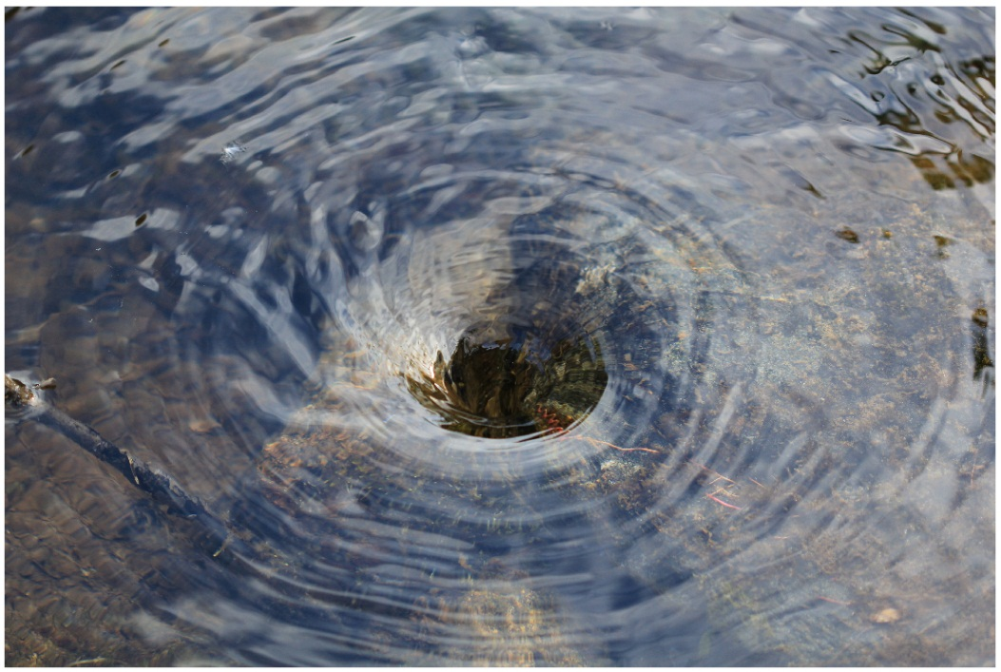
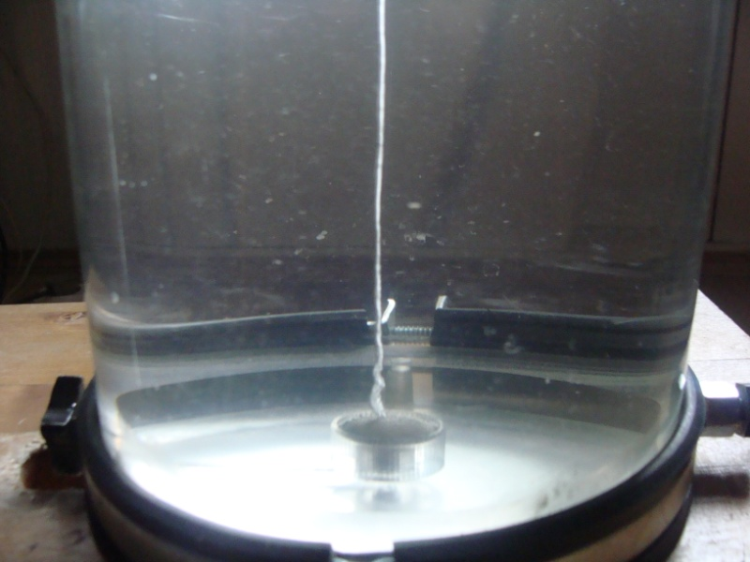
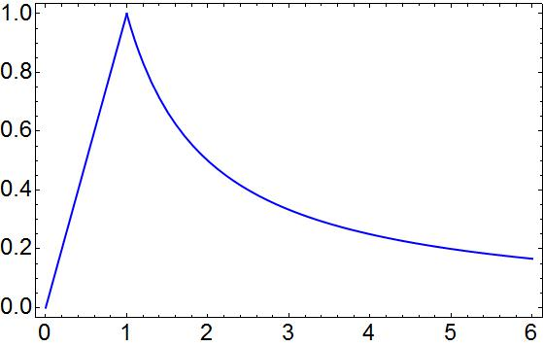
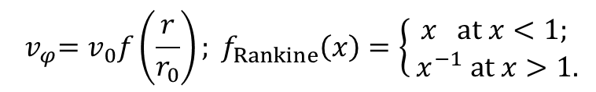
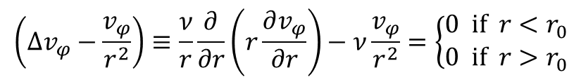
Rankine vortex in general hydrodynamic
Rankine W.J.M. Manual of Applied Mechanics, London, 1858.
Byalko A.V. Underwater Gas Tornado and Its Possible Occurrence in Nature, Procedia IUTAM 8 , 51 – 57, 2013.
$${ v}_{φ}=v_{0}f\left(\frac{r}{r_{0}}\right); f_{Rankine}\left(x\right)=\left\{\begin{aligned}x at x<1; \\ { x}^{−1} at x>1.\end{aligned}\right.$$
The viscosity term for Rankine vortex in Navier-Stokes equations is equal to zero!
$$\left({∆v}_{φ}−\frac{v_{φ}}{r^{2}}\right)≡\frac{ν}{r}\frac{∂}{∂r}\left(r\frac{∂v_{φ}}{∂r}\right)−ν\frac{v_{φ}}{r^{2}}=\left\{\begin{aligned}0 if r<r_{0} \\ 0 if r>r_{0}\end{aligned}\right.$$

Slide 3
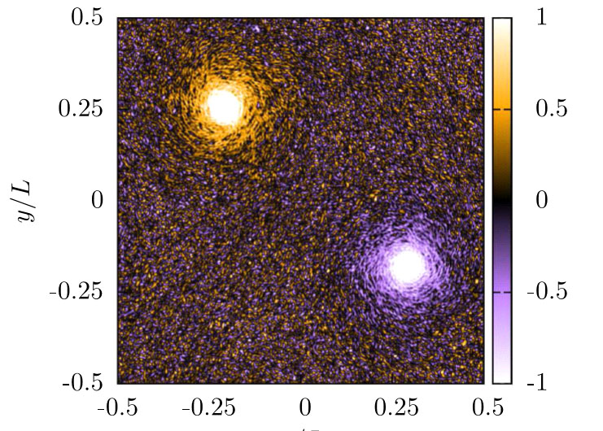
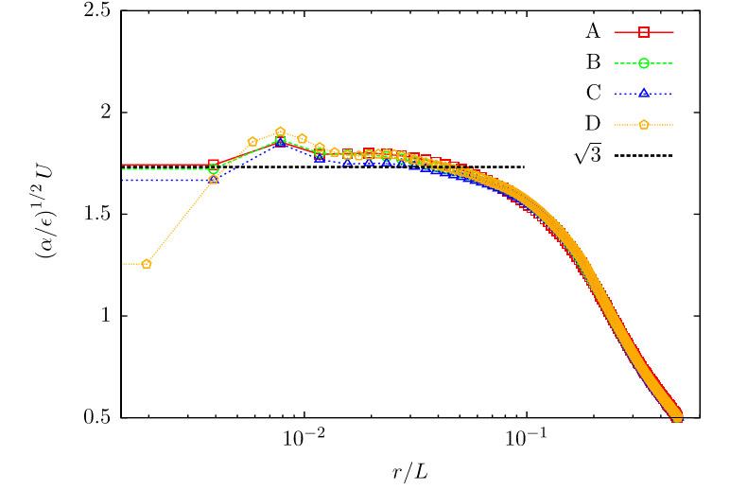
Stable 2-dimentional vortex
Jason L. et al. Universal Profile of the Vortex Condensate in Two-Dimensional Turbulence PRL 113, 254503 (2014)
An inverse turbulent cascade in a restricted
two-dimensional periodic domain creates a condensate—a pair of coherent system-size vortices.
The vortices have a universal internal structure independent of the type of small-scale
dissipation, small-scale forcing, and boundary conditions.
Radial profile of the mean polar velocity
U in log-lin coordinates.

Slide 4
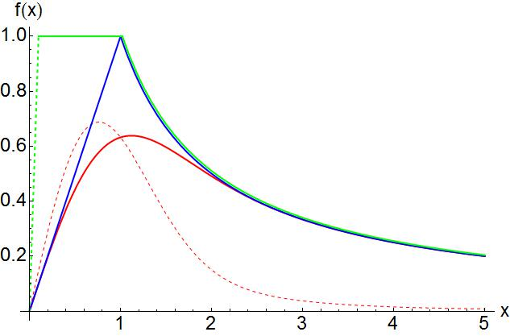
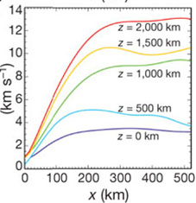
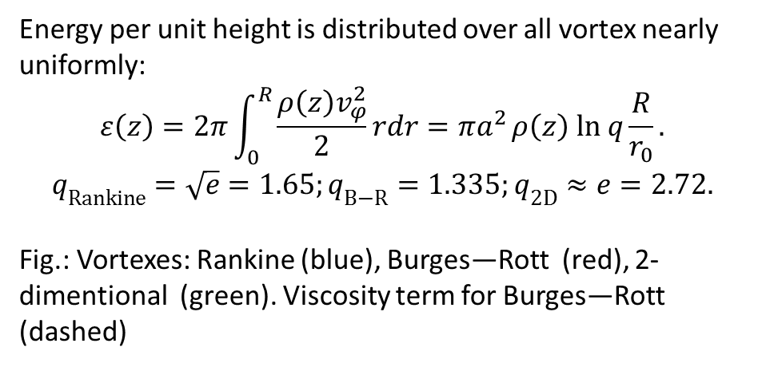


Burgers—Rott vortex is an exact solution of Navier-Stokes equations
$${ v}_{r}=−αr; { v}_{z}=2α\left(z−z_{0}\right);{ v}_{φ}=v_{0}f_{Burges−Rott}(\frac{r}{r_{0}}); r_{0}^{2}=\frac{2ν}{α}.$$
where $α>0; v_{0},{ z}_{0} are arbitrary constants and$
$$f_{Burgers−Rott}\left(x\right)=\left(1−e^{−x^{2}}\right){ x}^{−1}=\left\{\begin{aligned}x at x≪1; \\ { x}^{−1} at x≫1.\end{aligned}\right.$$
The viscosity term for Burges—Rott vortex is proportional to $ν\left[1−e^{−x^{2}}(1+x^{2}−x^{4})\right]{ x}^{−3}$
(dashed curve), it is located near the vortex core x=1.
Energy per unit height is distributed over all vortex nearly uniformly:
$$ε\left(z\right)=2π\int_{0}^{R}{\frac{{ρ\left(z\right)v}_{φ}^{2}}{2}}rdr={πa}^{2}ρ\left(z\right) ln q{\frac{R}{r_{0}}}.$$
$$q_{Rankine}=\sqrt{e}=1.65;q_{B−R}=1.335;q_{2D}≈e=2.72.$$
Fig.: Vortexes: Rankine (blue), Burges—Rott (red), 2-dimentional (green). Viscosity term for Burges—Rott (dashed)

Slide 5
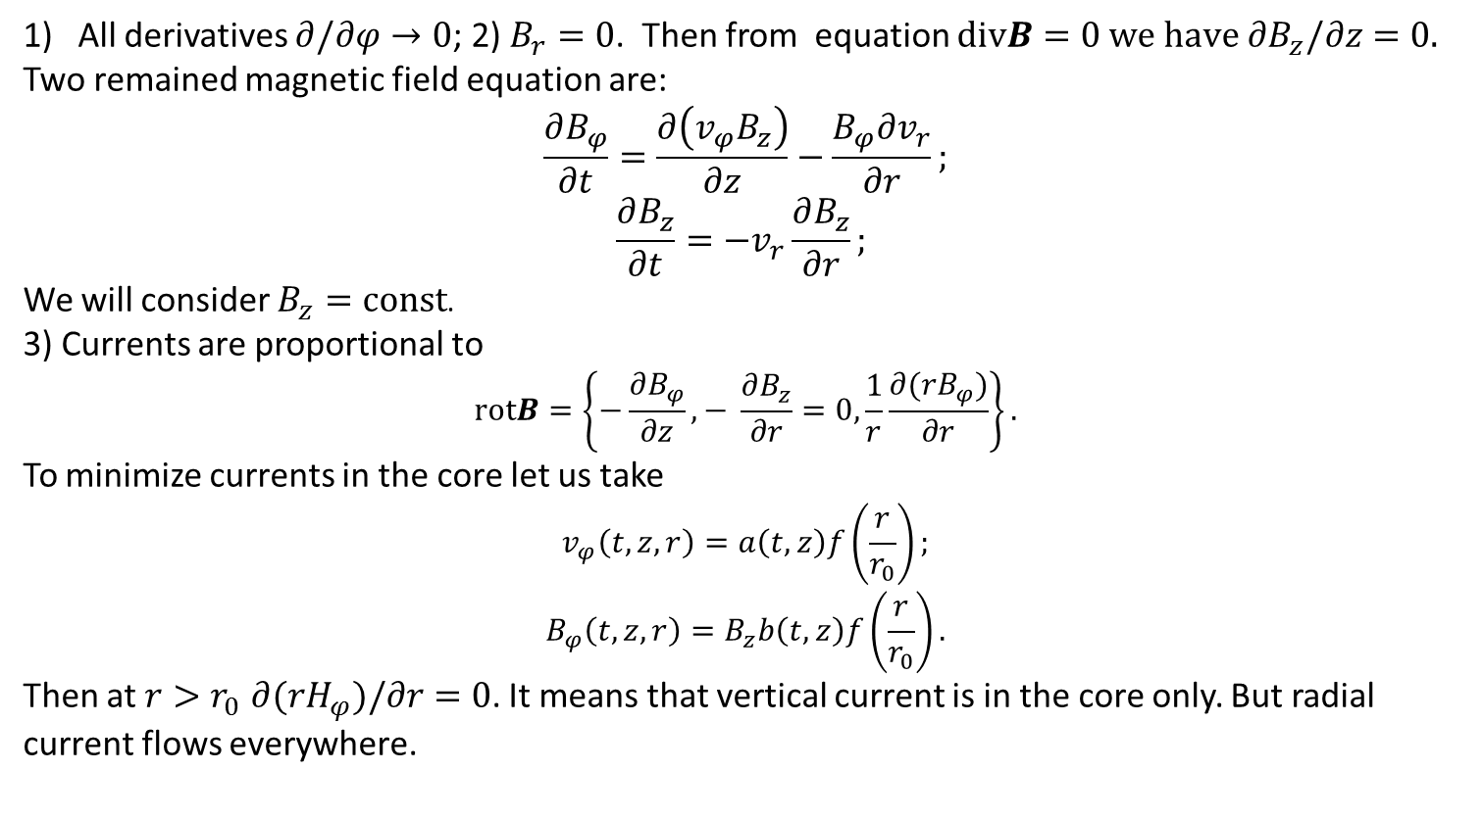
MHD equations in cylindrical coordinates
An example: Bisnovatyi-Kogan G. S. Mon.Not.R. Astron. Soc. 376, 457–464, 2007.
All derivatives $∂/∂φ→0$; 2) $B_{r}=0$. Then from equation $divB=0 we have ∂B_{z}/∂z=0.$
Two remained magnetic field equation are:
$$\frac{∂B_{φ}}{∂t}=\frac{∂\left({v_{φ}B}_{z}\right)}{∂z}−\frac{B_{φ}∂v_{r}}{∂r};$$
$$\frac{∂B_{z}}{∂t}=−v_{r}\frac{∂B_{z}}{∂r};$$
We will consider $B_{z}=const$.
3) Currents are proportional to
$$rotB=\left\{−\frac{∂B_{φ}}{∂z},− \frac{∂B_{z}}{∂r}=0,\frac{1}{r}\frac{∂{(rB}_{φ})}{∂r}\right\}.$$
To minimize currents in the core let us take
$$v_{φ}\left(t,z,r\right)=a\left(t,z\right)f\left(\frac{r}{r_{0}}\right);$$
$$B_{φ}\left(t,z,r\right)=B_{z}b\left(t,z\right)f\left(\frac{r}{r_{0}}\right).$$
Then at $r>r_{0}$ $∂{(rH}_{φ})/∂r=0$. It means that vertical current is in the core only. But radial current flows everywhere.

Slide 6
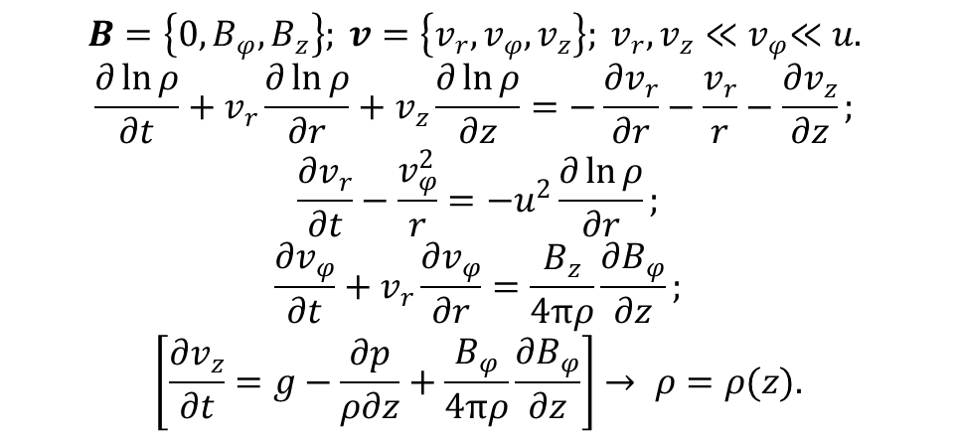
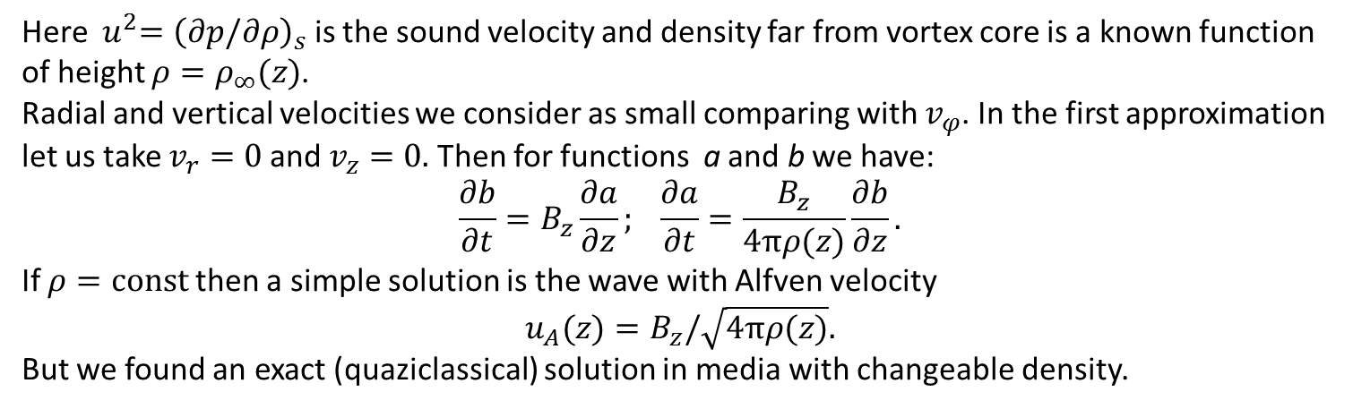
Velocity MHD-equations linear on $v_{r},v_{z}$
$$B=\left\{0,B_{φ},B_{z}\right\}; v=\left\{v_{r},v_{φ},v_{z}\right\}; v_{r},v_{z}{≪v}_{φ}≪u.$$
$$\frac{∂\ln{ρ}}{∂t}+v_{r}\frac{∂\ln{ρ}}{∂r}+v_{z}\frac{∂\ln{ρ}}{∂z}=−\frac{∂v_{r}}{∂r}−\frac{v_{r}}{r}−\frac{∂v_{z}}{∂z};$$
$$\frac{∂v_{r}}{∂t}−\frac{v_{φ}^{2}}{r}=−u^{2}\frac{∂\ln{ρ}}{∂r};$$
$$\frac{∂v_{φ}}{∂t}+v_{r}\frac{∂v_{φ}}{∂r}=\frac{B_{z}}{4πρ}\frac{∂B_{φ}}{∂z};$$
$$\left[\frac{∂v_{z}}{∂t}=g−\frac{∂p}{ρ∂z}+\frac{B_{φ}}{4πρ}\frac{∂B_{φ}}{∂z}\right]→ ρ=ρ(z).$$
Here ${ u}^{2}={\left(∂p/∂ρ\right)}_{s}$ is the sound velocity and density far from vortex core is a known function of height $ρ=ρ_{∞}(z)$.
Radial and vertical velocities we consider as small comparing with $v_{φ}$. In the first approximation let us take $v_{r}=0$and $v_{z}=0.$ Then for functions a and b we have:
$$\frac{∂b}{∂t}=B_{z}\frac{∂a}{∂z}; \frac{∂a}{∂t}=\frac{B_{z}}{4πρ(z)}\frac{∂b}{∂z}.$$
If $ρ=const$ then a simple solution is the wave with Alfven velocity
$$u_{A}(z)=B_{z}/\sqrt{4πρ(z)}.$$
But we found an exact (quaziclassical) solution in media with changeable density.

Slide 7
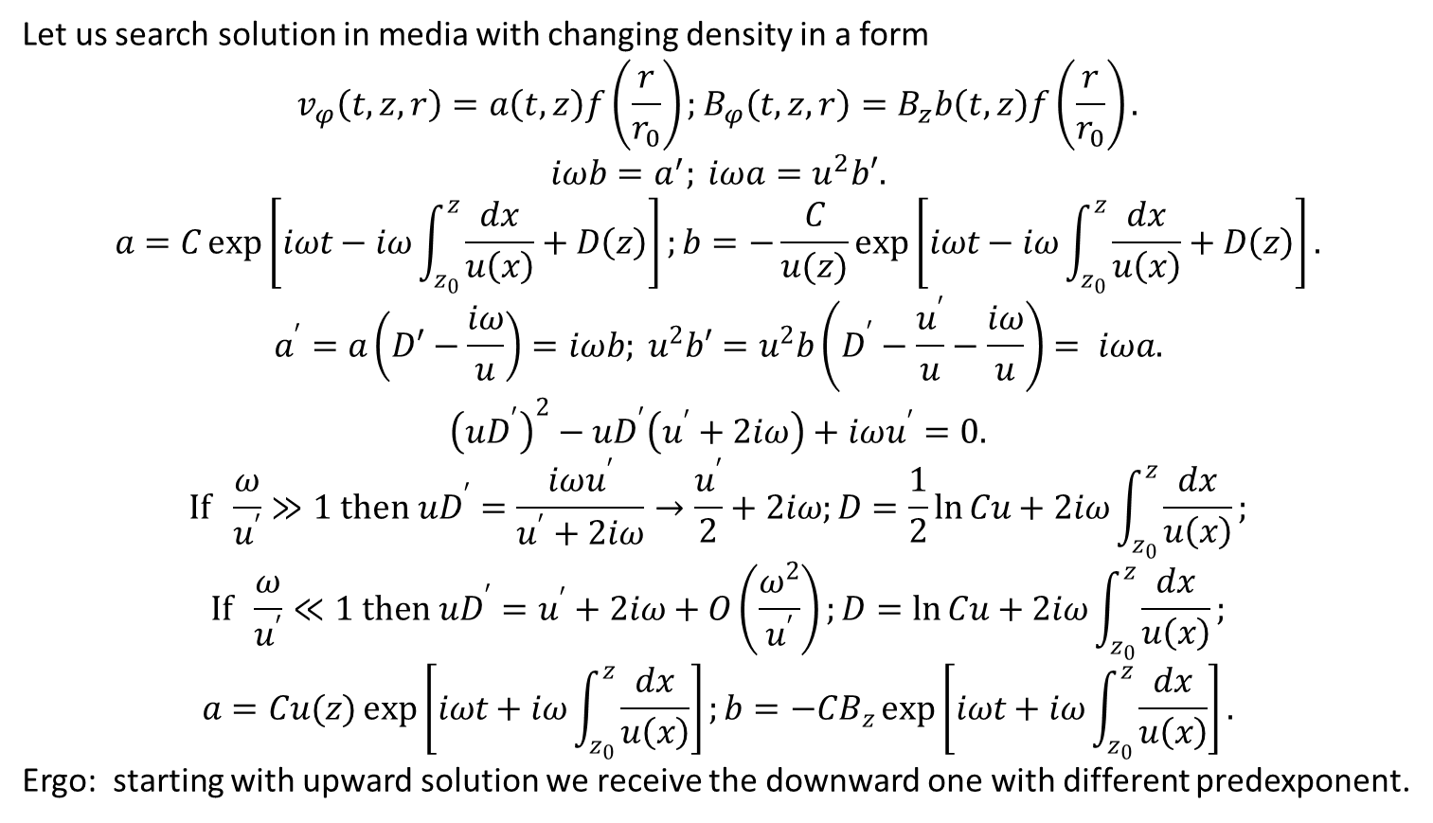
Quazi-classical approximation
Let us search solution in media with changing density in a form
$$v_{φ}\left(t,z,r\right)=a\left(t,z\right)f\left(\frac{r}{r_{0}}\right);B_{φ}\left(t,z,r\right)=B_{z}b\left(t,z\right)f\left(\frac{r}{r_{0}}\right).$$
$$iωb=a^{′}; iωa=u^{2}b′.$$
$$a=C\exp\left[iωt−iω\int_{z_{0}}^{z}{\frac{dx}{u\left(x\right)}+D\left(z\right)}\right];b=−\frac{C}{u(z)}\exp\left[iωt−iω\int_{z_{0}}^{z}{\frac{dx}{u\left(x\right)}}+D\left(z\right)\right].$$
$$a^{′}=a\left(D′−\frac{iω}{u}\right)=iωb; u^{2}b′=u^{2}b\left(D^{′}−\frac{u^{′}}{u}−\frac{iω}{u}\right)= iωa.$$
$${\left(uD^{′}\right)}^{2}−uD^{′}\left(u^{′}+2iω\right)+iωu^{′}=0.$$
$$If \frac{ω}{u^{′}}≫1 then uD^{′}=\frac{iωu^{′}}{u^{′}+2iω}→\frac{u^{′}}{2}+2iω;D=\frac{1}{2}\ln{Cu}+2iω\int_{z_{0}}^{z}{\frac{dx}{u\left(x\right)}};$$
$$If \frac{ω}{u^{′}}≪1 then uD^{′}=u^{′}+2iω+O\left(\frac{ω^{2}}{u^{′}}\right);D=\ln{Cu}+2iω\int_{z_{0}}^{z}{\frac{dx}{u\left(x\right)}};$$
$$a=Cu(z)\exp\left[iωt+iω\int_{z_{0}}^{z}{\frac{dx}{u\left(x\right)}}\right];b=−CB_{z}\exp\left[iωt+iω\int_{z_{0}}^{z}{\frac{dx}{u\left(x\right)}}\right].$$
Ergo: starting with upward solution we receive the downward one with different predexponent.

Slide 8
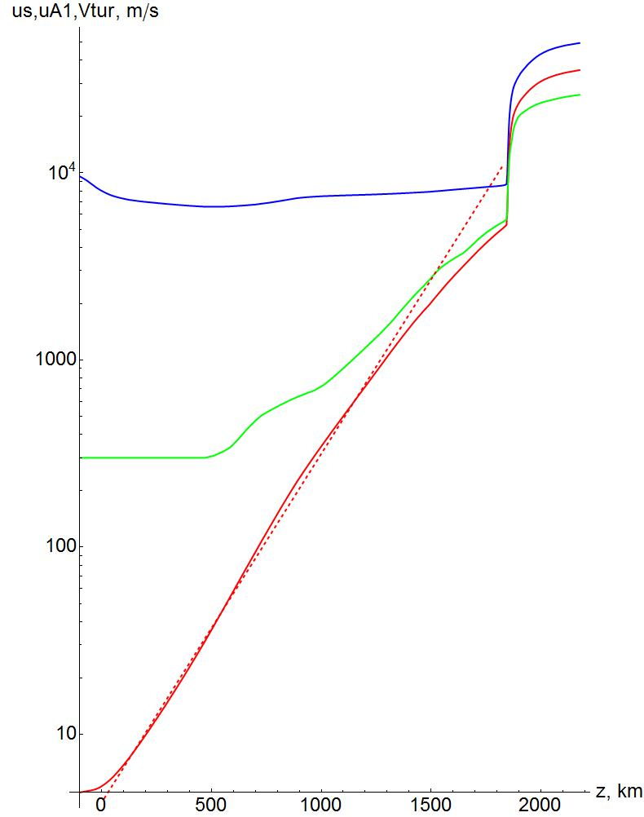
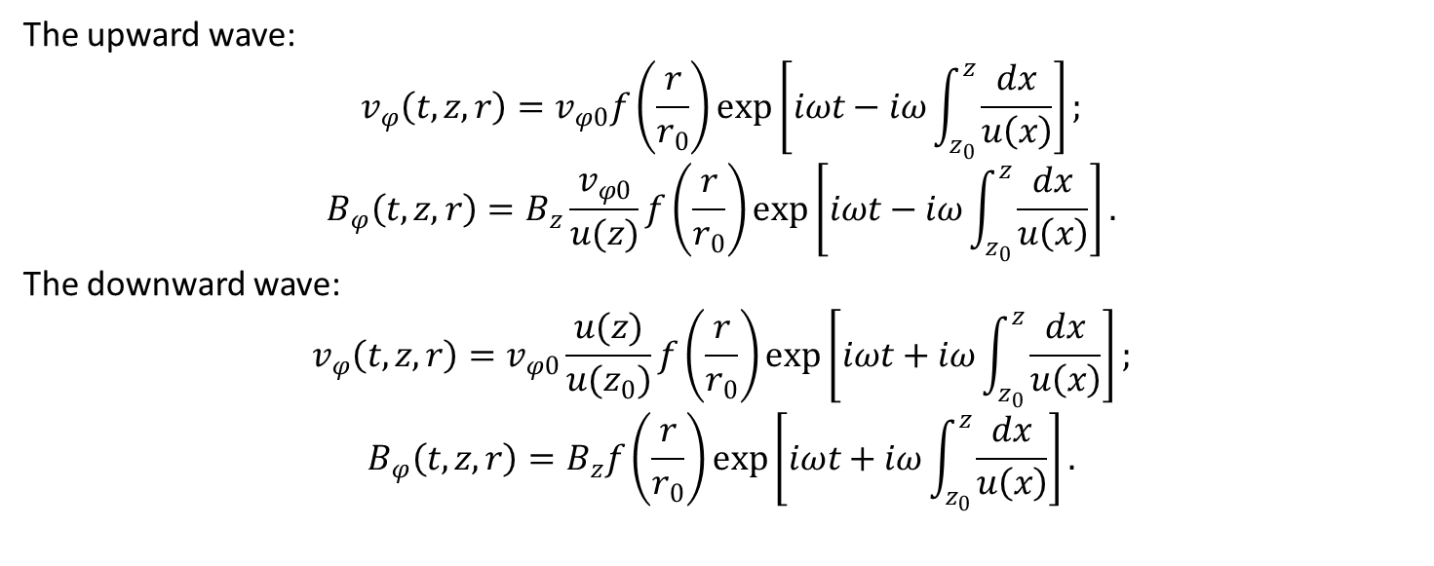
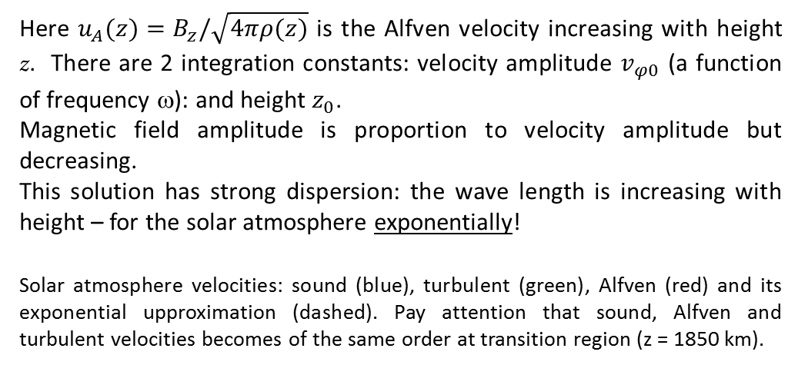
An exact (quazi-classical) MHD solution: a torsion Alfven waves
The upward wave:
$$v_{φ}\left(t,z,r\right)=v_{φ0}f\left(\frac{r}{r_{0}}\right)\exp\left[iωt−iω\int_{z_{0}}^{z}{\frac{dx}{u\left(x\right)}}\right];$$
$$B_{φ}\left(t,z,r\right)=B_{z}\frac{v_{φ0}}{u(z)}f\left(\frac{r}{r_{0}}\right)\exp\left[iωt−iω\int_{z_{0}}^{z}{\frac{dx}{u\left(x\right)}}\right].$$
The downward wave:
$$v_{φ}\left(t,z,r\right)=v_{φ0}\frac{u(z)}{u(z_{0})}f\left(\frac{r}{r_{0}}\right)\exp\left[iωt+iω\int_{z_{0}}^{z}{\frac{dx}{u\left(x\right)}}\right];$$
$$B_{φ}\left(t,z,r\right)=B_{z}f\left(\frac{r}{r_{0}}\right)\exp\left[iωt+iω\int_{z_{0}}^{z}{\frac{dx}{u\left(x\right)}}\right].$$
Here $u_{A}(z)=B_{z}/\sqrt{4πρ(z)}$ is the Alfven velocity increasing with height z. There are 2 integration constants: velocity amplitude $v_{φ0}$ (a function of frequency ω): and height $z_{0}$.
Magnetic field amplitude is proportion to velocity amplitude but decreasing.
This solution has strong dispersion: the wave length is increasing with height – for the solar atmosphere exponentially!
Solar atmosphere velocities: sound (blue), turbulent (green), Alfven (red) and its exponential upproximation (dashed). Pay attention that sound, Alfven and turbulent velocities becomes of the same order at transition region (z = 1850 km).

Slide 9
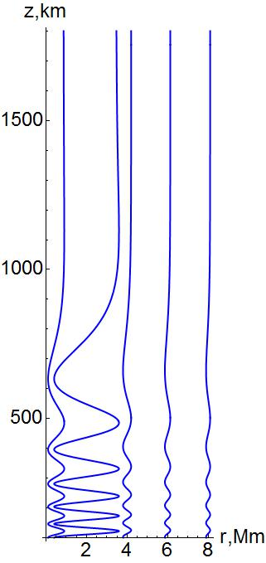
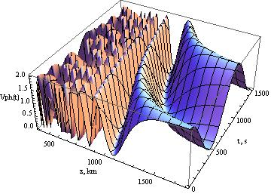
Graphical presentation of torsion Alfven upward wave
The torsion Alfven upward wave in dependence on height z and time t for a frequency with a period T = 10 min.

Slide 10
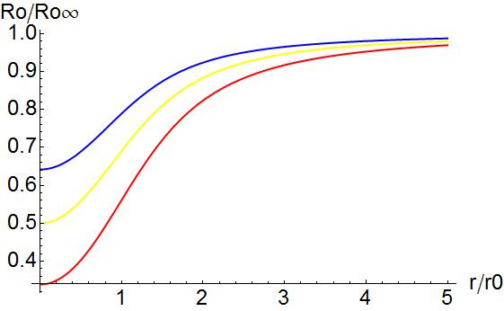
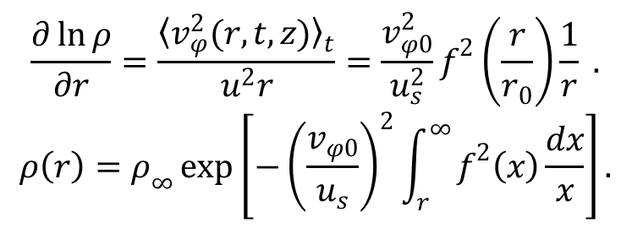
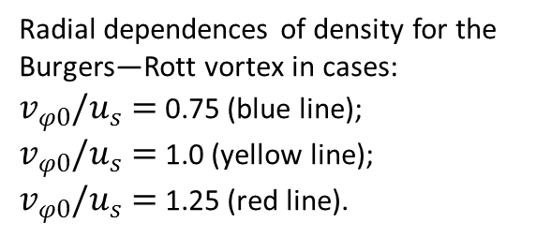
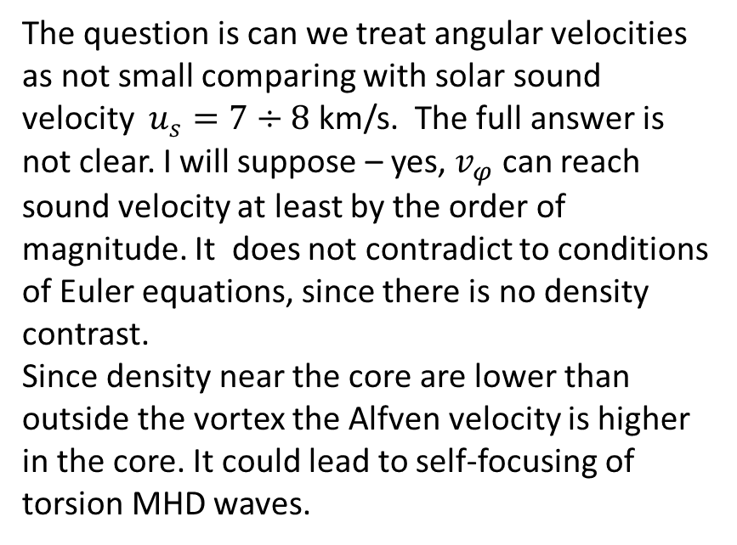
Radial dependence of vortex density: $\frac{∂v_{r}}{∂t}−\frac{v_{φ}^{2}}{r}=−u^{2}\frac{∂\ln{ρ}}{∂r}.$
Neglecting small radial velocities we can solve its time-averaged equation. There is no magnetic field in it; the radial variable could be separated from z and t. Thus we can integrate it to obtain the density dependence:
$$\frac{∂\ln{ρ}}{∂r}=\frac{{〈v_{φ}^{2}(r,t,z)〉}_{t}}{u^{2}r}=\frac{v_{φ0}^{2}}{u_{s}^{2}}f^{2}\left(\frac{r}{r_{0}}\right)\frac{1}{r} .$$
$$ρ\left(r\right)=ρ_{∞}\exp\left[−{\left(\frac{v_{φ0}}{u_{s}}\right)}^{2}\int_{r}^{∞}{f^{2}\left(x\right)\frac{dx}{x}}\right].$$
The question is can we treat angular velocities as not small comparing with solar sound velocity $u_{s}=7÷8$ km/s. The full answer is not clear. I will suppose – yes, $v_{φ}$ can reach sound velocity at least by the order of magnitude. It does not contradict to conditions of Euler equations, since there is no density contrast.
Since density near the core are lower than outside the vortex the Alfven velocity is higher in the core. It could lead to self-focusing of torsion MHD waves.
Radial dependences of density for the Burgers—Rott vortex in cases:
$v_{φ0}/u_{s}=$ 0.75 (blue line);
$v_{φ0}/u_{s}=$ 1.0 (yellow line);
$v_{φ0}/u_{s}=$ 1.25 (red line).
Radial velocities (km/s)

Slide 11
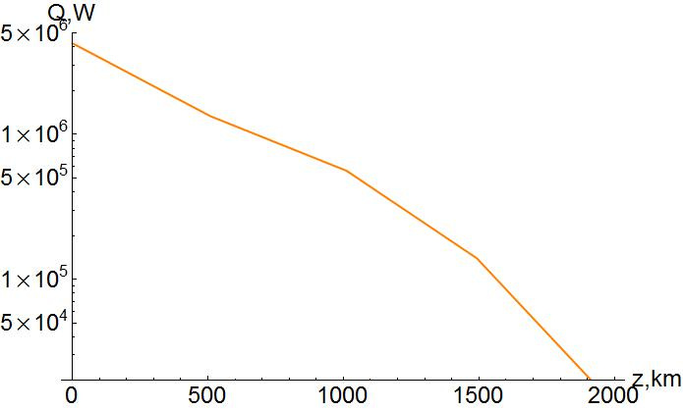
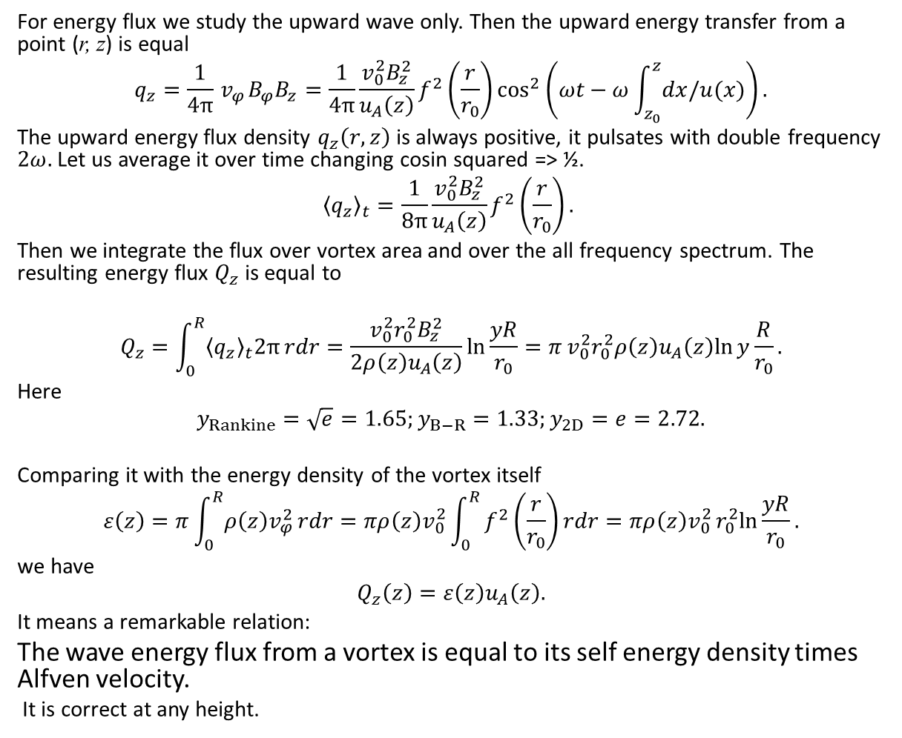
Wave energy transfer
For energy flux we study the upward wave only. Then the upward energy transfer from a point (r, z) is equal
$$q_{z}=\frac{1}{4π}{ v}_{φ}B_{φ}B_{z}=\frac{1}{4π}\frac{v_{0}^{2}B_{z}^{2}}{u_{A}\left(z\right)}f^{2}\left(\frac{r}{r_{0}}\right)\cos^{2}\left(ωt−ω\int_{z_{0}}^{z}{dx/u(x)}\right).$$
The upward energy flux density $q_{z}\left(r,z\right)$ is always positive, it pulsates with double frequency $2ω.$Let us average it over time changing cosin squared => ½.
$${〈q_{z}〉}_{t}=\frac{1}{8π}\frac{v_{0}^{2}B_{z}^{2}}{u_{A}\left(z\right)}f^{2}\left(\frac{r}{r_{0}}\right).$$
Then we integrate the flux over vortex area and over the all frequency spectrum. The resulting energy flux $Q_{z}$ is equal to
$$Q_{z}=\int_{0}^{R}{{〈q_{z}〉}_{t}2π}rdr=\frac{v_{0}^{2}r_{0}^{2}B_{z}^{2}}{2ρ\left(z\right)u_{A}\left(z\right)}\ln{\frac{yR}{r_{0}}}=πv_{0}^{2}r_{0}^{2}ρ\left(z\right)u_{A}\left(z\right)ln{y\frac{R}{r_{0}}}.$$
Here
$$y_{Rankine}=\sqrt{e}=1.65;y_{B−R}=1.33;y_{2D}=e=2.72.$$
Comparing it with the energy density of the vortex itself
$$ε\left(z\right)=π\int_{0}^{R}{ρ\left(z\right)v_{φ}^{2}}rdr=πρ\left(z\right)v_{0}^{2}\int_{0}^{R}{f^{2}\left(\frac{r}{r_{0}}\right)}rdr=πρ\left(z\right)v_{0}^{2}r_{0}^{2}ln{\frac{yR}{r_{0}}}.$$
we have
$$Q_{z}\left(z\right)=ε\left(z\right)u_{A}\left(z\right).$$
It means a remarkable relation:
The wave energy flux from a vortex is equal to its self energy density times Alfven velocity.
It is correct at any height.

Slide 12
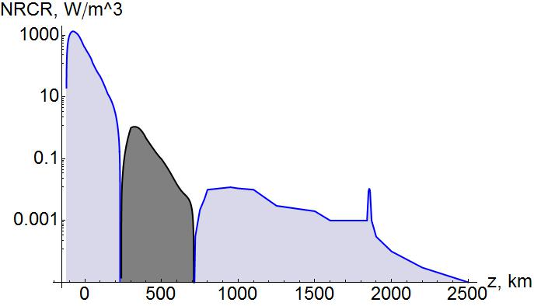
Net radiative cooling rates (NRCR), or net radiative losses is sum over all lines and continua.
In a steady state, the total net radiation cooling rate must be balanced by the non-radiative (mechanical or magnetic) heating needed to produce the given atmosphere. Negative total rate in the temperature minimum region occurs mainly due to ion H–. (E. Avrett et al.).
The problem is to find a way to transfer energy flux F₂ from photosphere to chromosphere.
Solar flux: F_{S} = 6.3153 10⁷ Wm⁻²;
Integrated fluxes:
F₁ = 1.28 10⁸ Wm⁻² = 2F_{S};
F₂ = – 1.4 10⁵ Wm⁻² = – 2 10⁻³ F_{S};
F₃ = 5.6 10³ Wm⁻² ~ 0.01% F_{S}.
Photosphere
Transition region
Chromosphere

Slide 13
Net radiative cooling rates (NRCR), or net radiative losses is sum over all lines and continua.
In a steady state, the total net radiation cooling rate must be balanced by the non-radiative (mechanical or magnetic) heating needed to produce the given atmosphere. Negative total rate in the temperature minimum region occurs mainly due to ion H–. (E. Avrett et al.).
The problem is to find a way to transfer energy flux F₂ from photosphere to chromosphere.
Solar flux: F_{S} = 6.3153 10⁷ Wm⁻²;
Integrated fluxes:
F₁ = 1.28 10⁸ Wm⁻² = 2F_{S};
F₂ = – 1.4 10⁵ Wm⁻² = – 2 10⁻³ F_{S};
F₃ = 5.6 10³ Wm⁻² ~ 0.01% F_{S}.
Photosphere
Transition region
Chromosphere

Slide 14
Results and discussion
A solution for MHD equations in ideal plasma was obtained. It is a torsion Alfven wave with dispersion based on Rankine type vortex.
The upward mode of this wave transfer energy up in a pulsating way. This upward energy transfer occurs in all vortex region.
The vortex wave energy flux is equal to the vortex energy times Alfven velocity.
Energy dissipation occurs mainly in the vortex core due to viscosity and all over the vortex due to electric conductivity.
Sound waves generated by pulsating torsion wave do not disturb the main solution.
Density in the vortex core is lower than in its outside region. It opens a possibility for a self-focusing of torsion wave and formation of solitons.
An attempt to explain the negative region in the Net Radiative Cooling Rate (NRCR) occur to be unsuccessful.

Slide 15
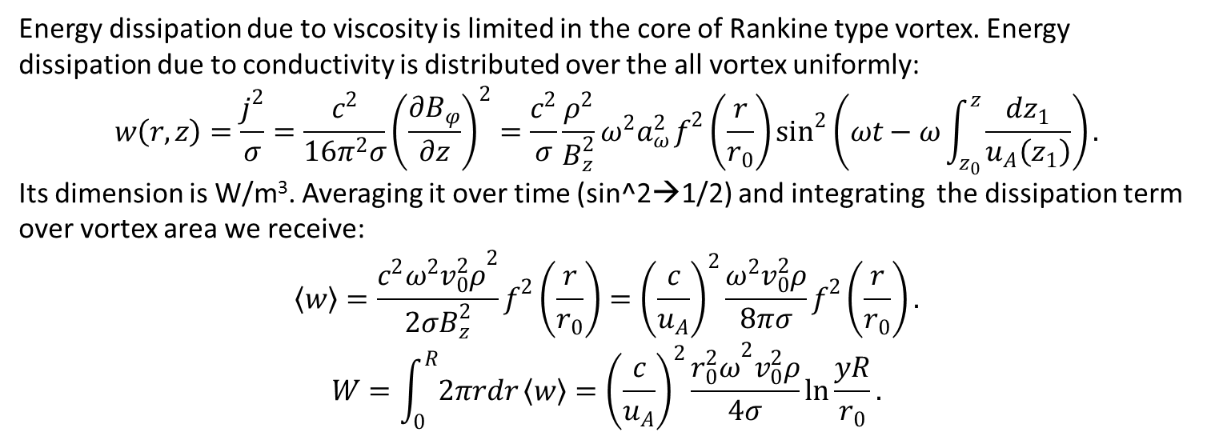
Wave energy dissipation
Energy dissipation due to viscosity is limited in the core of Rankine type vortex. Energy dissipation due to conductivity is distributed over the all vortex uniformly:
$$w\left(r,z\right)=\frac{j^{2}}{σ}=\frac{c^{2}}{16π^{2}σ}{\left(\frac{∂B_{φ}}{∂z}\right)}^{2}=\frac{c^{2}}{σ}\frac{ρ^{2}}{B_{z}^{2}}ω^{2}a_{ω}^{2}f^{2}\left(\frac{r}{r_{0}}\right)\sin^{2}\left(ωt−ω\int_{z_{0}}^{z}{\frac{dz_{1}}{u_{A}\left(z_{1}\right)}}\right).$$
Its dimension is W/m³. Averaging it over time (sin^2→1/2) and integrating the dissipation term over vortex area we receive:
$$〈w〉=\frac{c^{2}{ω^{2}v_{0}^{2}ρ}^{2}}{2σB_{z}^{2}}f^{2}\left(\frac{r}{r_{0}}\right)={\left(\frac{c}{u_{A}}\right)}^{2}\frac{ω^{2}v_{0}^{2}ρ}{8πσ}f^{2}\left(\frac{r}{r_{0}}\right).$$
$$W=\int_{0}^{R}{2πrdr}〈w〉={\left(\frac{c}{u_{A}}\right)}^{2}\frac{{r_{0}^{2}ω}^{2}v_{0}^{2}ρ}{4σ}\ln{\frac{yR}{r_{0}}}.$$

