Slide 1
Solar Atmosphere
A review based on paper:
E. Avrett, et al. “Modeling the Chromosphere of a Sunspot and the Quiet Sun” and some others
[Alexey V. Byalko]
Landau Institute of Theoretical Physics, Russian Academy of Sciences, Chernogolovka, Moscow oblast, 142432 Russia
& journal “Priroda” RAS email: alexey@byalko.ru www.byalko.com/alexey

Slide 2
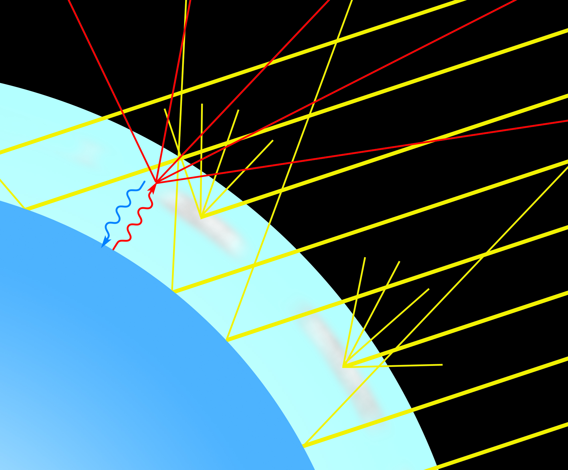
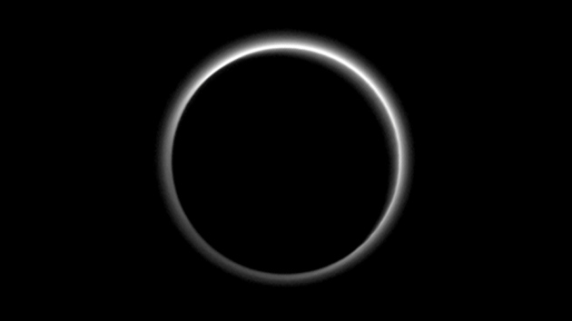
Planet atmospheres as a paradox of science
Do we have a reasonable theory of clouds?
– No.
Do we understand thunderstorm electric charge separation?
– No.
Do we understand rare lightning events in upper atmosphere : sprite halos, blue jets and so on?
– No.
Energy flux and convection lead to known
types of instability.
Pluto’s atmosphere

Slide 3
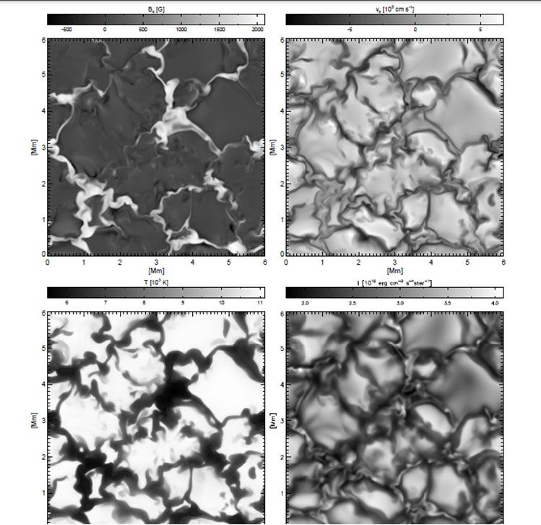
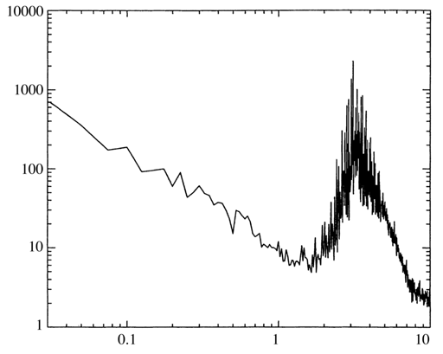
Solar cells
Vogler A. Stimulating Radiative Magnito-convection in the Solar Photosphere.
Lower right: intensity;
Lower left: temperature, K;
Upper right: vertical velocity;
Upper left: vertical magnetic
Field, Gs.
5 min
Spectrum of solar surface oscillations

Slide 4
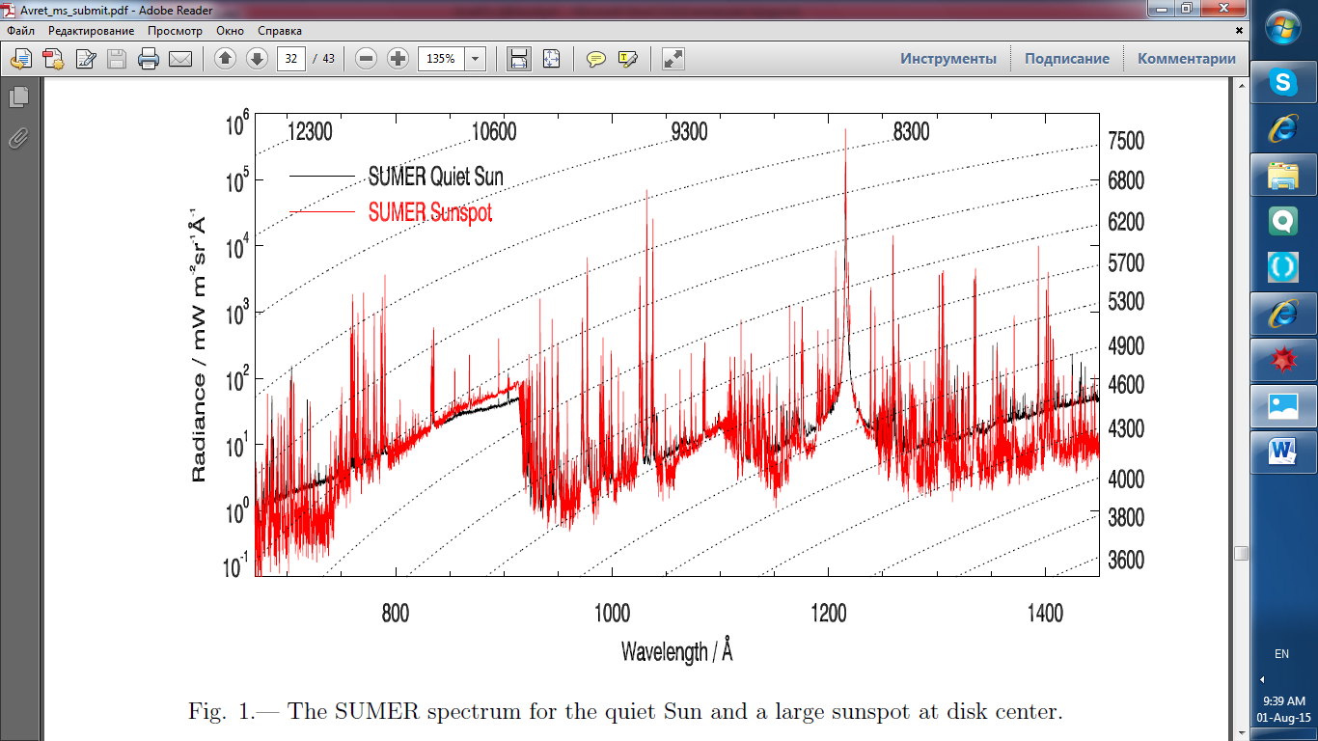
Curdt W. et al. SUMER atlas, A&A, 375, 591 (2001).

Slide 5
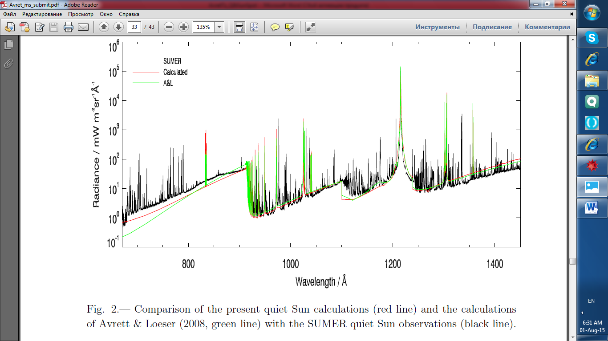

Slide 6
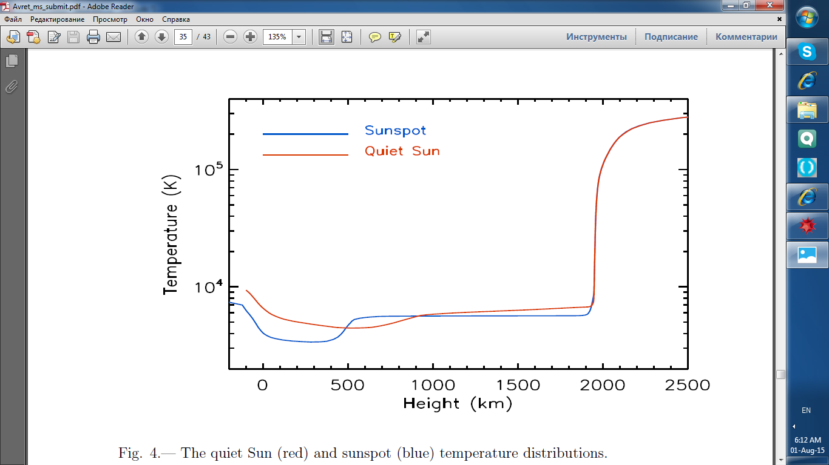

Slide 7
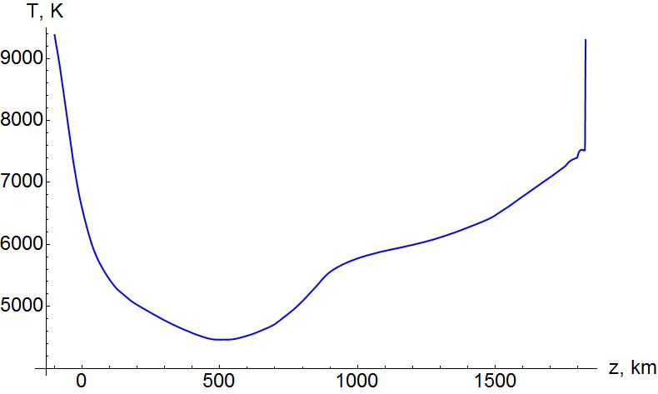
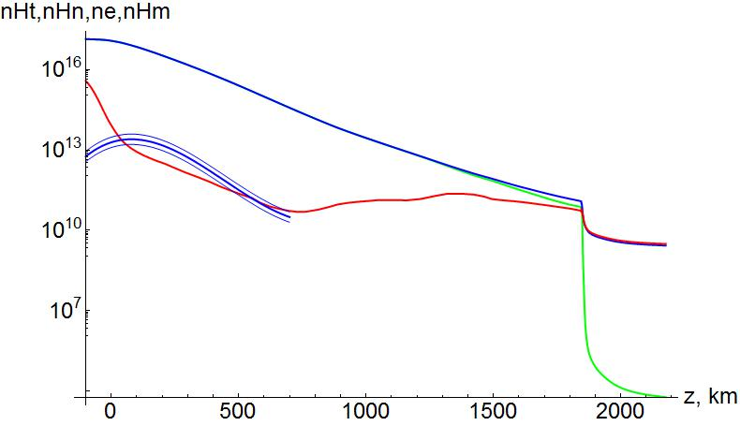
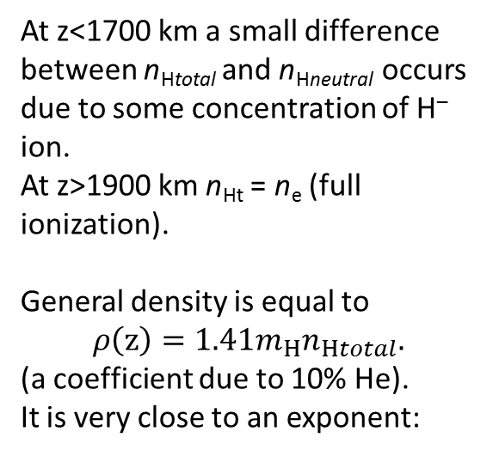
Temperature [K] and densities [cm⁻³]
n_{Htotal} – blue;
n_{Hneutral} – green;
n_{e} – red;
n_{H—}– triple line
(calculated from others).
At z<1700 km a small difference between n_{Htotal} and n_{Hneutral} occurs due to some concentration of H– ion.
At z>1900 km n_{Ht} = n_{e} (full ionization).
General density is equal to
$$ρ\left(z\right)={{1.41m}_{H}n}_{Htotal}.$$
(a coefficient due to 10% He).
It is very close to an exponent:
$$ρ\left(100 km<z<1850 km\right)≈ρ_{0}\exp\left(−\frac{z}{H}\right);ρ_{0}=2.75 {10}^{−7}g cm^{−3};H= 127 km.$$

Slide 8
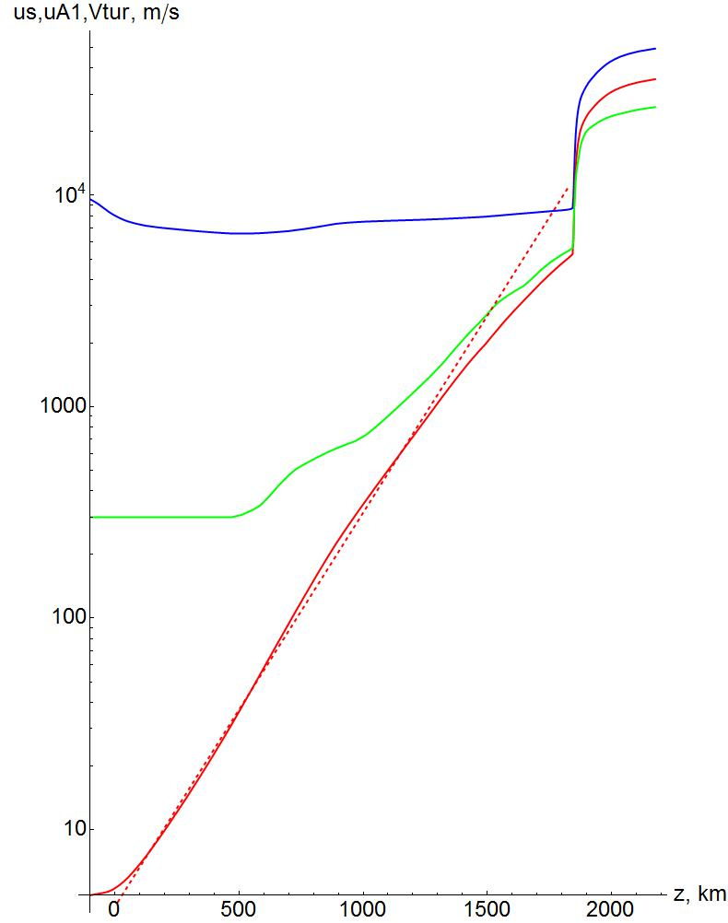
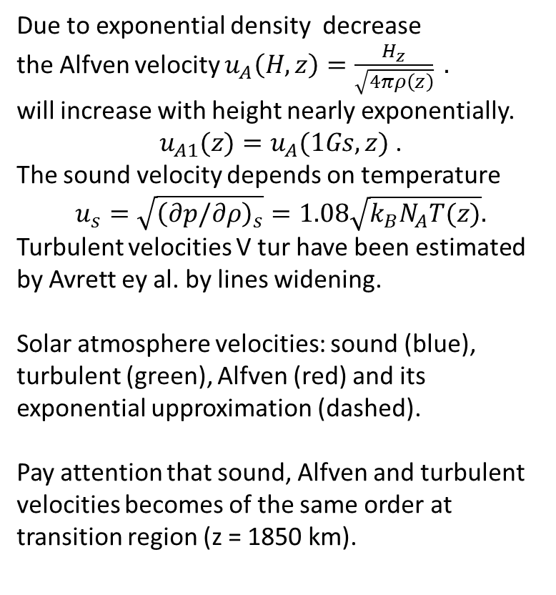
Velocities in the solar atmosphere
Due to exponential density decrease
the Alfven velocity $u_{A}\left(H,z\right)=\frac{H_{z}}{\sqrt{4πρ\left(z\right)}} .$
will increase with height nearly exponentially.
$u_{A1}(z)=u_{A}(1Gs,z)$ .
The sound velocity depends on temperature
$$u_{s}=\sqrt{{\left(∂p/∂ρ\right)}_{s}}=1.08\sqrt{k_{B}N_{A}T(z)}.$$
Turbulent velocities V tur have been estimated by Avrett ey al. by lines widening.
Solar atmosphere velocities: sound (blue), turbulent (green), Alfven (red) and its exponential upproximation (dashed).
Pay attention that sound, Alfven and turbulent velocities becomes of the same order at transition region (z = 1850 km).

Slide 9
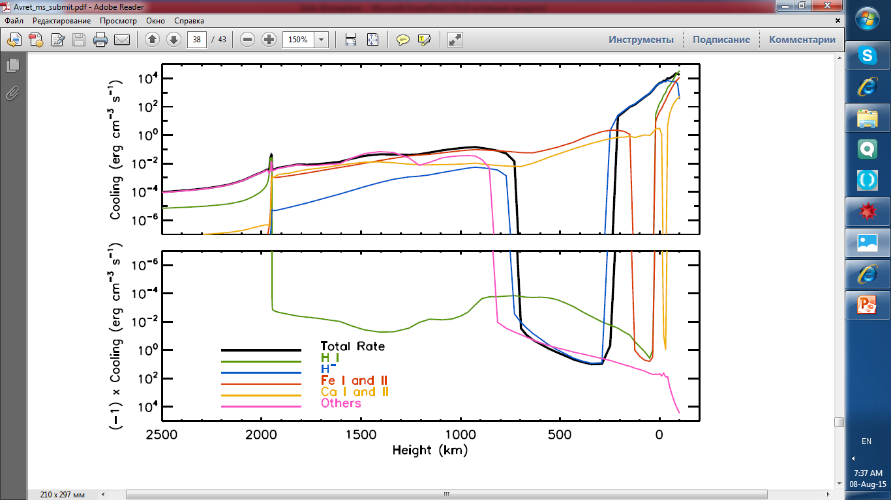
Net radiative cooling rates (NRCR). Avrett et al.

Slide 10
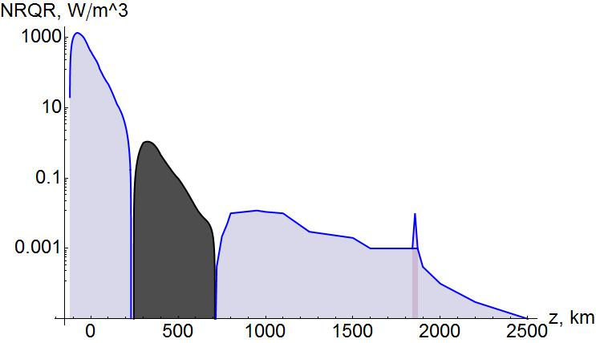
Net radiative cooling rates (NRQR), or net radiative losses is sum over all lines and continua.
In a steady state, the total net radiation cooling rate must be balanced by the non-radiative (mechanical or magnetic) heating needed to produce the given atmosphere. Negative total rate in the temperature minimum region occurs mainly due to ion H– radiation.(E. Avrett et al.)
Solar flux: F_{S} = 6.3153 10⁷ Wm⁻²;
Integrated fluxes:
F₁ = 1.28 10⁸ Wm⁻² = 2F_{S};
F₂ = – 1.4 10⁵ Wm⁻² = – 2 10⁻³ F_{S};
F₃ = 5.6 10³ Wm⁻² ~ 0.01% F_{S}.
Photosphere
Transition region
Chromosphere
F₁
F₂
F₃
Corona

Slide 11
Main results of E.Avrett solar modeling
There is a temperature minimum at z = 500 km.
Solar atmosphere is exponentially flat: its vertical scale is about 130 km only. Naturally, it is extremely small comparing with solar radius but it is also small comparing with solar cell sizes; their order of magnitude is 10000 km.
It means that Alfven velocity in solar atmosphere grows with height also exponentially.
The sound, Alfven and turbulent velocities becomes of the same order at transition region (z = 1850 km). This region is not modeled with sufficient accuracy.
Net radiative cooling rates (NRQR) are negative near the a temperature minimum region. NRQR must be balanced by the non-radiative heating.

Slide 12
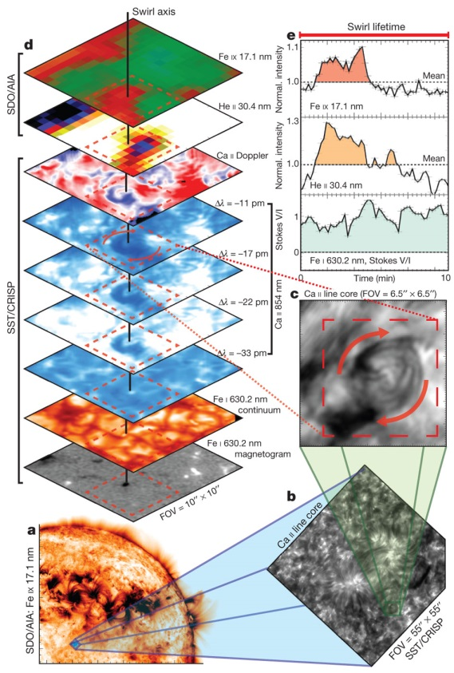
Magnetic tornadoes as energy channels into the solar corona
S. Wedemeyer-Bohm, et al, Nature 486, 505 (2012). Observation of a swirl event and its coronal counterpart.
Coaligned and co-temporal solar observations made on 8 May 2011 using the Atmospheric Imaging Assembly (AIA) on board NASA’s space-based Solar Dynamics Observatory (SDO) (cadence, 12 s; image scale, 0.699 per pixel) and the Crisp Imaging Spectropolarimeter (CRISP) on the ground-based, Swedish 1-m Solar Telescope (cadence, 14 s; 47 line positions across the Ca II 854.2-nm spectral line of the infrared triplet; image scale, 0.0699 per pixel). a, Part of the full-disk AIA Fe IX 17.1-nm channel with the field of view (FOV) of CRISP at the centre of the solar disk (blue box, 559935599). b, Corresponding CRISP image in the Ca II 854.2-nm line core. c, Close-up of the region with a chromospheric swirl. d, Layered atmosphere from the photosphere (bottom panel: magnetogram, Fe I 630.2-nm continuum), through the chromosphere (Dopplergram, Ca II 854.2 nm) and the transition region (He II 30.4 nm) to the low corona (top: Fe IX 17.1nm). The visible radiation of the lower solar atmosphere is compared with high-resolution imaging of the extreme ultraviolet radiation components. Here it is revealed that tornado-like swirls (c), previously only observed in the chromosphere, have a signal in the spectral lines formed in the hot solar corona (e). The line-of-sight component of the magnetic field (e, bottom) reveals the unipolar nature of the rotating structure.
The concurrent transition region (e, middle) and low normalized coronal intensity (e, top) reveal radiative emission during the lifetime of the swirl, thus implying heating.

Slide 13
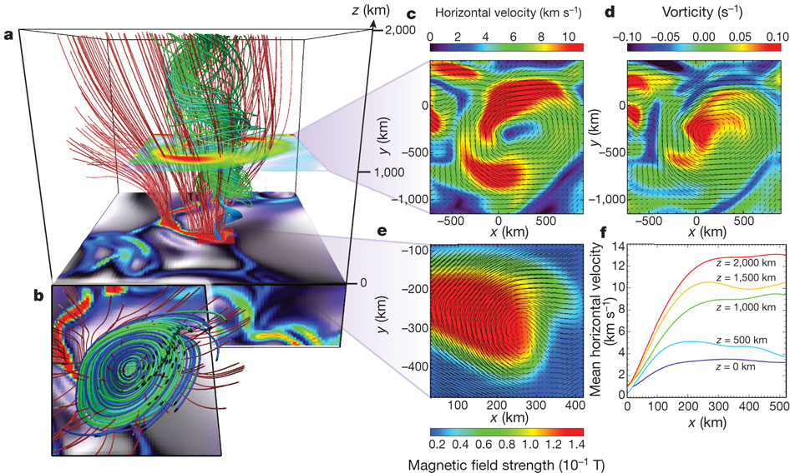
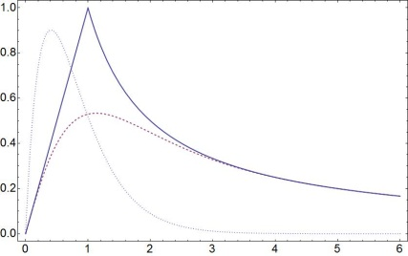
Magnetic tornadoes as energy channels into the solar corona
S. Wedemeyer-Bohm, et al, Nature 486, 505-508 (2012)
Numerical model of a swirl event produced with CO⁵BOLD

Slide 14
Review results
Thus, the problem of solar chromosphere and corona heating seems to be principally solved, i.e.:
Vortexes of the solar cell sizes generate magnetic waves propagating upwards. This concept is confirmed by observations and computer modeling with MHD-programs providing full 4D solutions.
But, 1) a theoretical consideration with exact MHD-solutions would be useful anyway ;
2) there exist an old problem of energy balance in solar atmosphere: we need a qualitative mechanism of energy transfer from photosphere to the region of temperature minimum.

