Slide 1
Tensile testing of Ti-6Al-4V alloy superplasticity
Sergey Aksenov, Ph.D.

Slide 2
Introduction
As a titanium alloys have remarkable properties in terms of mechanical characteristics, low density and elevated corrosion resistance, it is widely used in many fields including aerospace, automotive, electronics and even bio-medical industry. At the same time the semi-finished parts of titanium alloys are rather expensive in particular because of the number and complexity of technological operations. The superplastic forming (SPF) is an effective way to manufacture very complex thin-shape components, which allows at the same time to decrease its cost.
The major advantages of SPF:
The possibility of form a large and complex workpieces in one operation
Excellent precision of a finished products
Fine surface finish of a products

Slide 3
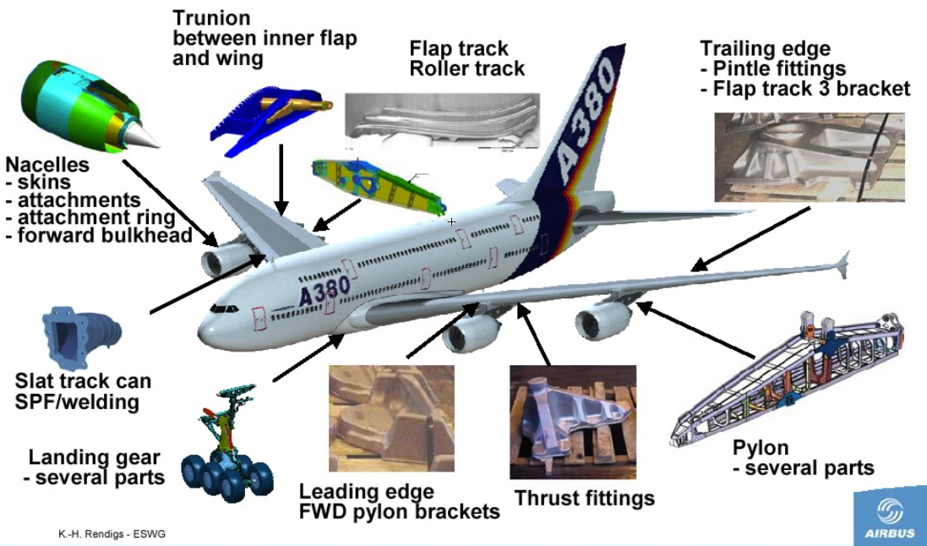
Typical titanium alloys SPF applications

Slide 4
Material
Ti-6Al-4V is the most popular titanium alloy which covered more than 50% of titanium alloy production
Physical properties:
Density 4.42 g/cm3
Melting Range 1649±15 °C
Specific Heat 560 J/(kg °C)
Mechanical properties:
Tensile Strength 1000 Mpa
Elastic Modulus 114 Gpa
Chemical composition
C
Fe
N2
O2
Al
V
H2
Ti
< 0.08%
< 0.25%
< 0.05%
< 0.2%
5.5-6.76%
3.5-4.5%
< 0.015%
Balance

Slide 5
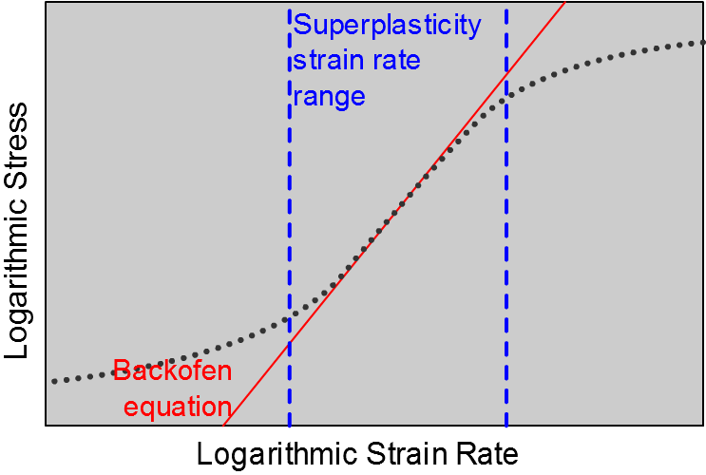
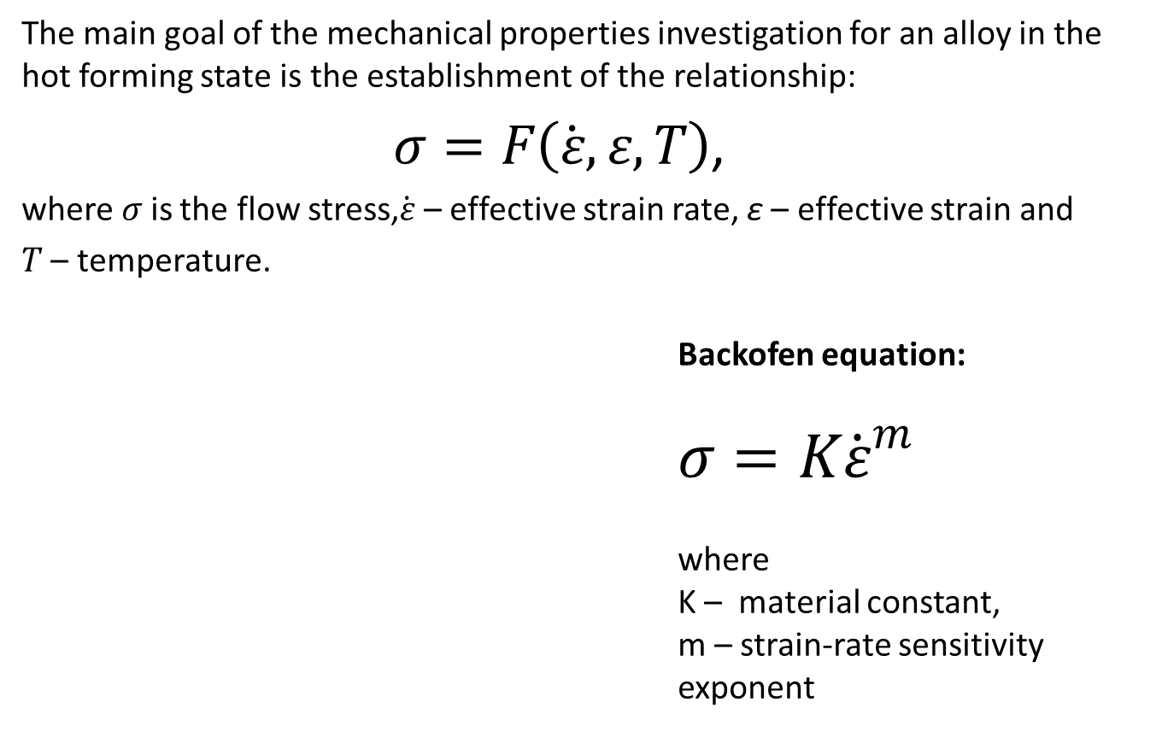
Constitutive model
The main goal of the mechanical properties investigation for an alloy in the hot forming state is the establishment of the relationship:
$σ=F\left(\dot{ε}, ε,T\right)$,
where $σ$ is the flow stress,$\dot{ε}$ – effective strain rate, ε – effective strain and
$T$ – temperature.
Backofen equation:
$$σ=K{\dot{ε}}^{m}$$
where
K – material constant,
m – strain-rate sensitivity exponent

Slide 6
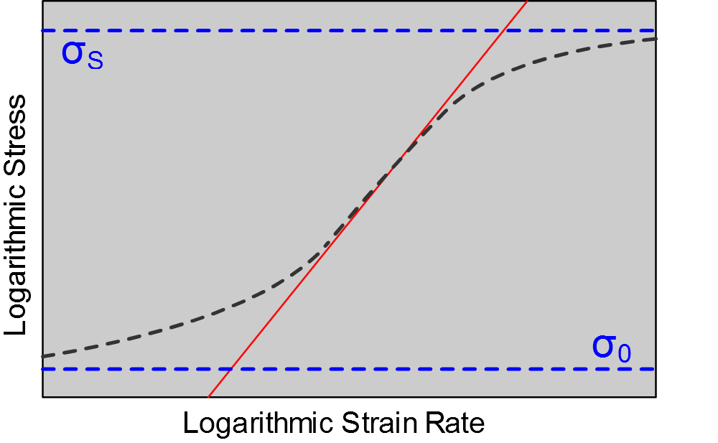
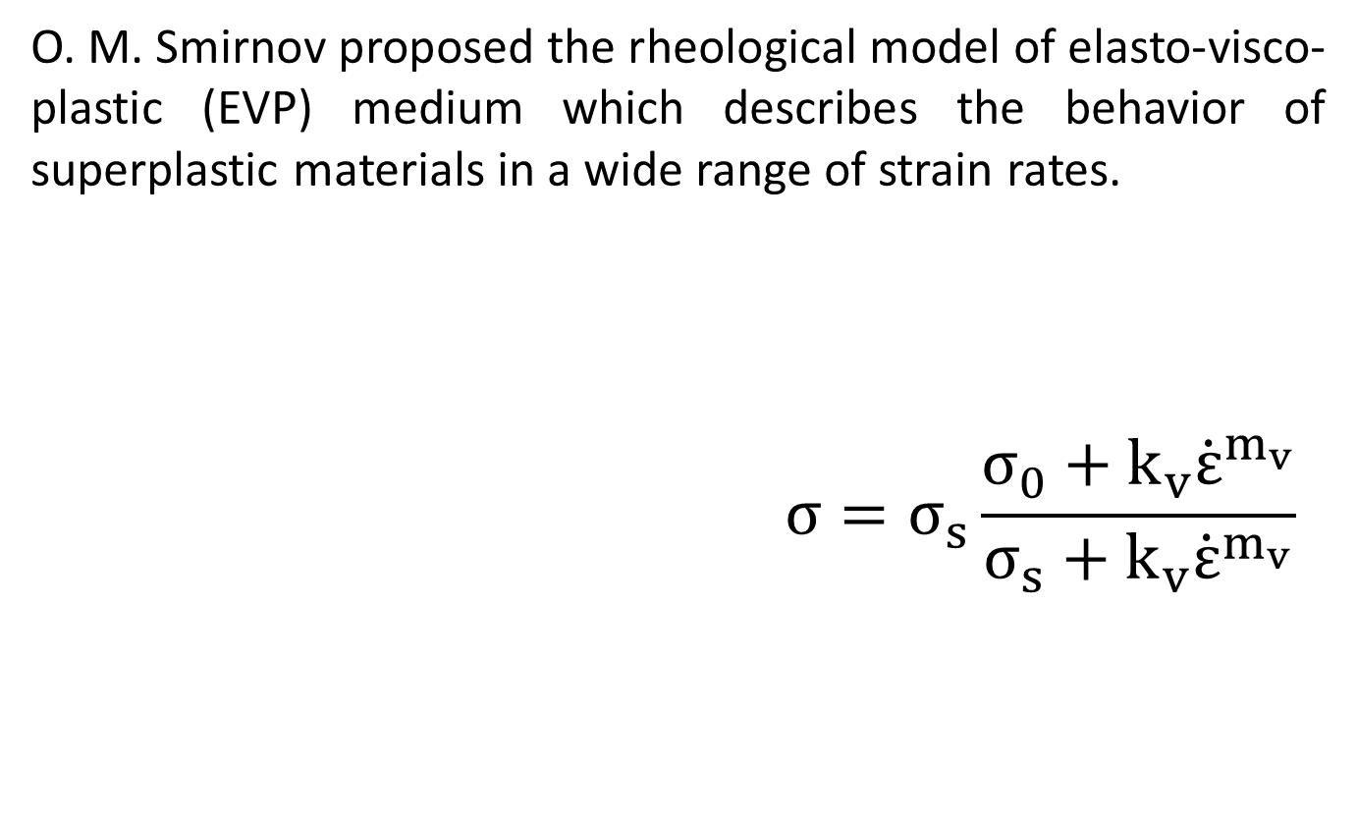
Constitutive model
O. M. Smirnov proposed the rheological model of elasto-visco-plastic (EVP) medium which describes the behavior of superplastic materials in a wide range of strain rates.
$$σ=σ_{s}\frac{σ_{0}+k_{v}{\dot{ε}}^{m_{v}}}{σ_{s}+k_{v}{\dot{ε}}^{m_{v}}}$$

Slide 7
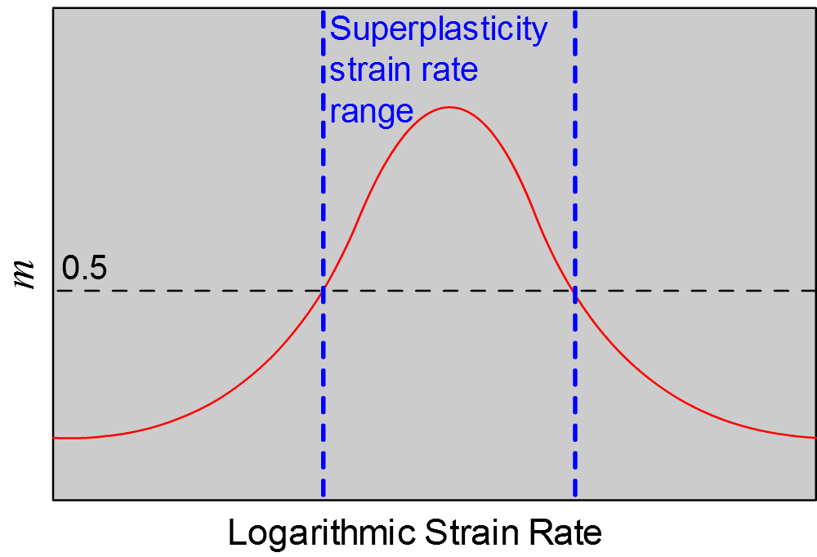
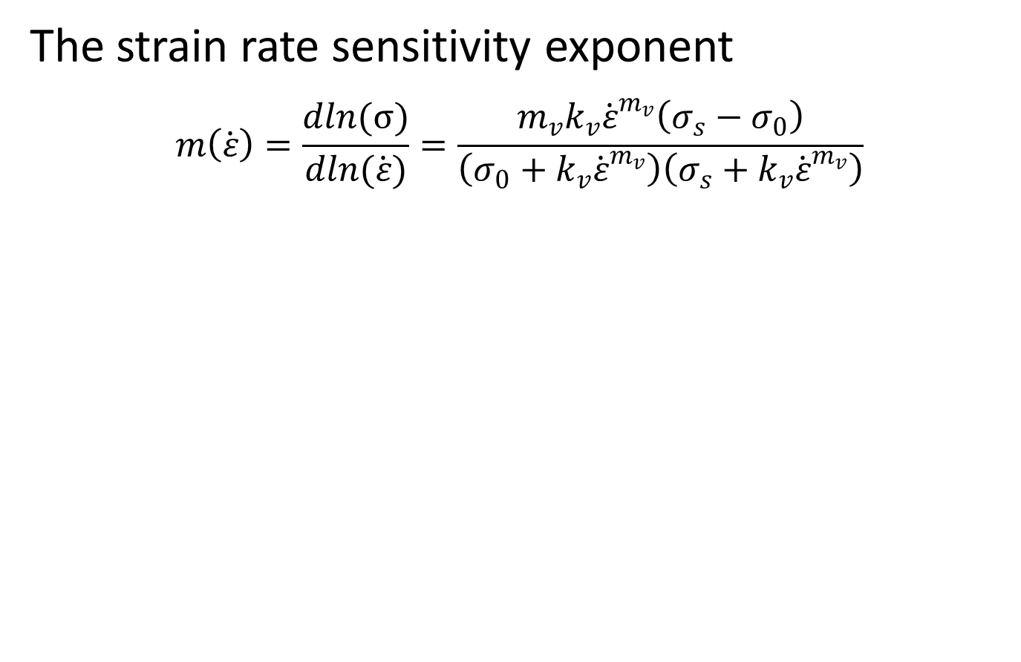
Constitutive model
The strain rate sensitivity exponent
$$m\left(\dot{ε}\right)=\frac{dln(σ)}{dln(\dot{ε})}=\frac{m_{v}k_{v}{\dot{ε}}^{m_{v}}\left(σ_{s}−σ_{0}\right)}{\left(σ_{0}+k_{v}{\dot{ε}}^{m_{v}}\right)\left(σ_{s}+k_{v}{\dot{ε}}^{m_{v}}\right)}$$

Slide 8
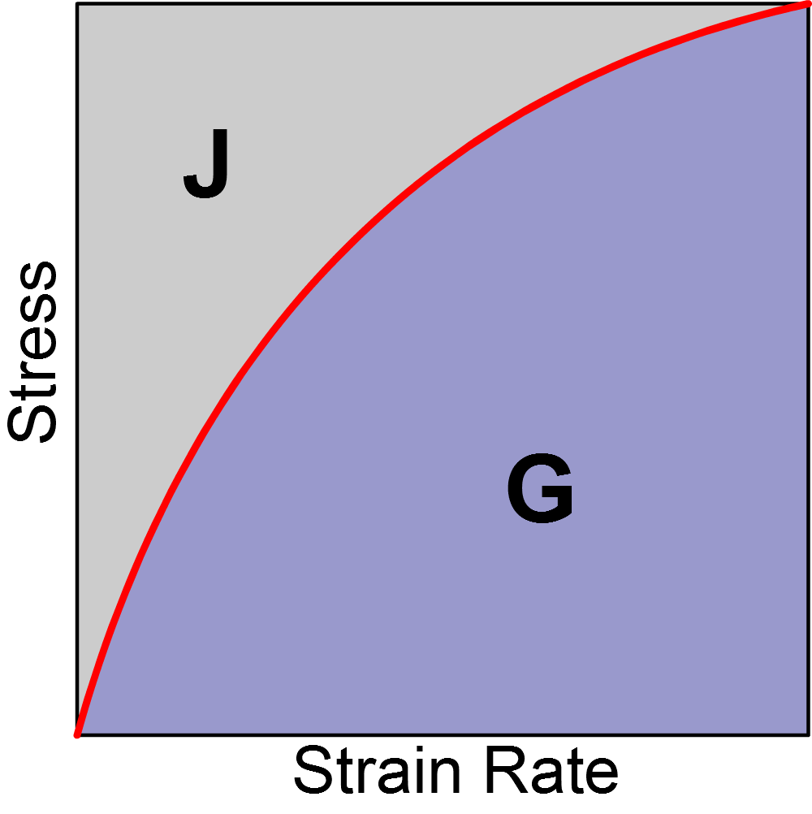
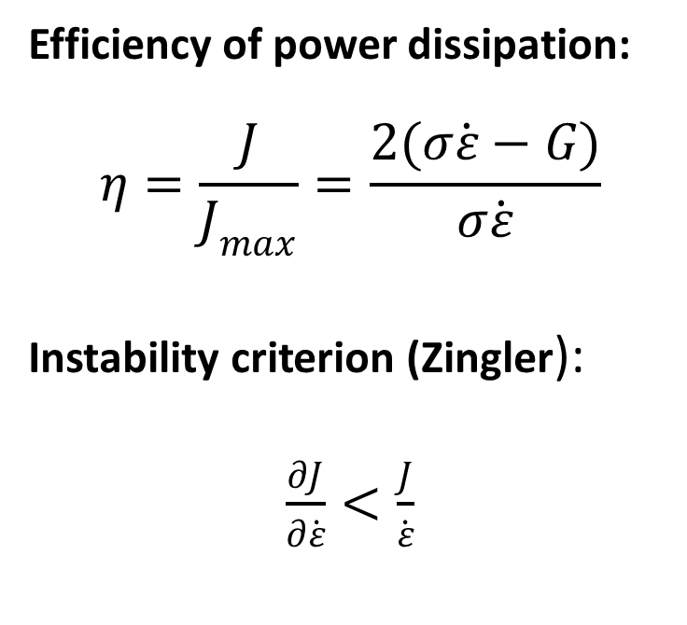

Dynamic materials model
Y.V.R.K. Prasad et al. suggested the dynamic materials modeling (DMM) approach for describing the material behavior under processing conditions by means of processing maps.
Efficiency of power dissipation:
$$η=\frac{J}{J_{max}}=\frac{2(σ\dot{ε}−G)}{σ\dot{ε}}$$
Instability criterion (Zingler):
$\frac{∂J}{∂\dot{ε}}<\frac{J}{\dot{ε}}$
$$σ=f(\dot{ε})$$

Slide 9
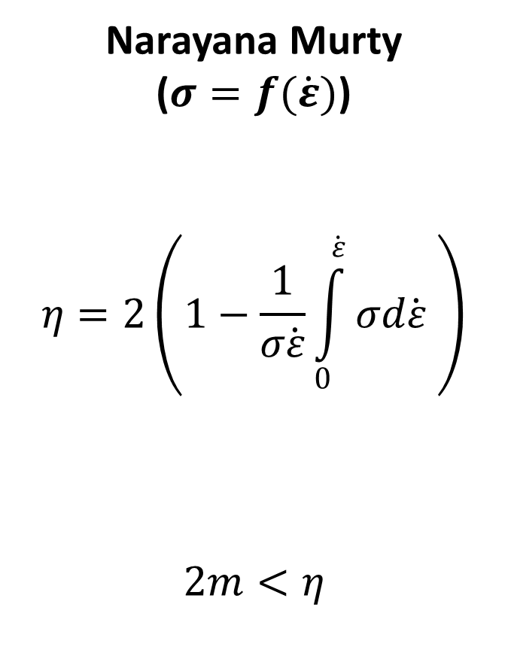
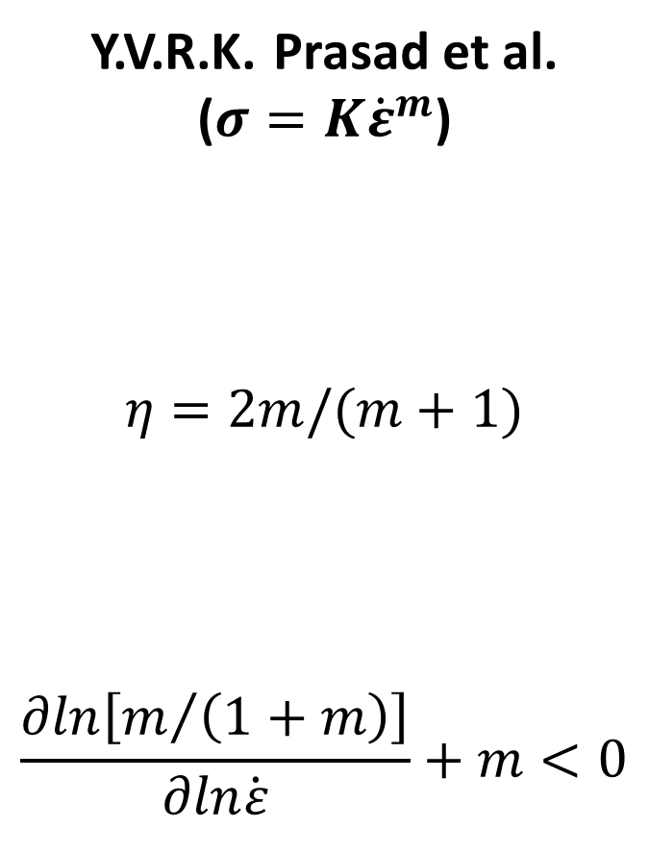
Dynamic materials model
Y.V.R.K. Prasad et al.
($σ=K{\dot{ε}}^{m}$)
$η=2m/(m+1)$
$$\frac{∂ln\left[m/{\left(1+m\right)}\right]}{∂ln\dot{ε}}+m<0$$
Narayana Murty
($σ=f(\dot{ε})$)
$$η=2\left(1−\frac{1}{σ\dot{ε}}\int_{0}^{\dot{ε}}{σd\dot{ε}} \right)$$
$$2m<η$$
Efficiency of power dissipation
Instability criterion

Slide 10
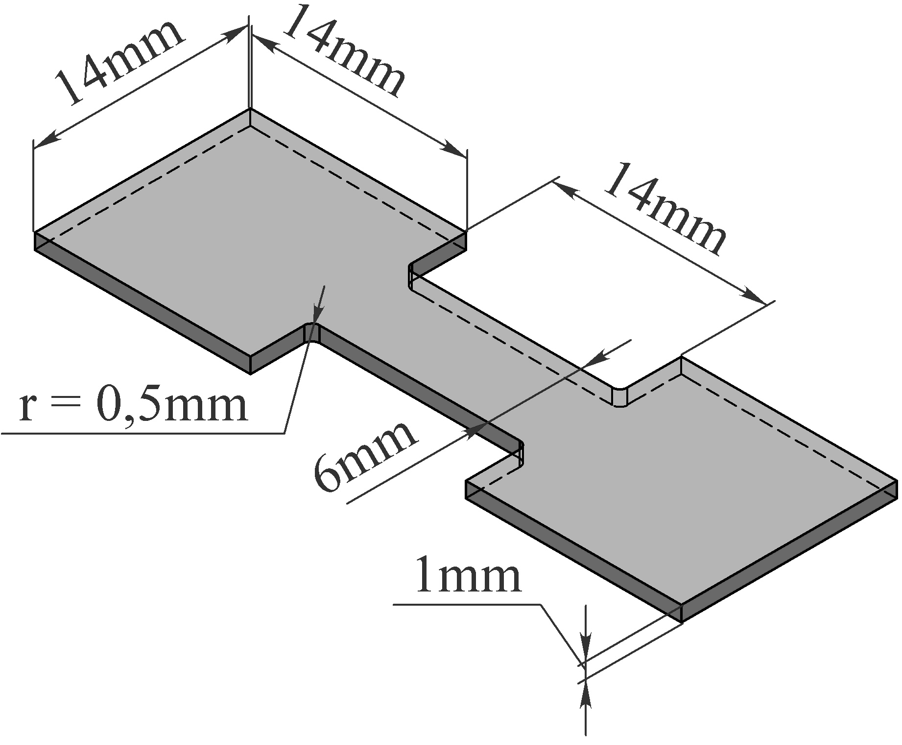
Experiment
As received Ti-6Al-4V alloy was used in the investigation. Each specimen was set in clamps of the test machine, placed in the furnace and heated up to the preset temperature. Then isothermal tensile-tests were carried out in the temperature range of 700 – 925 °С.

Slide 11
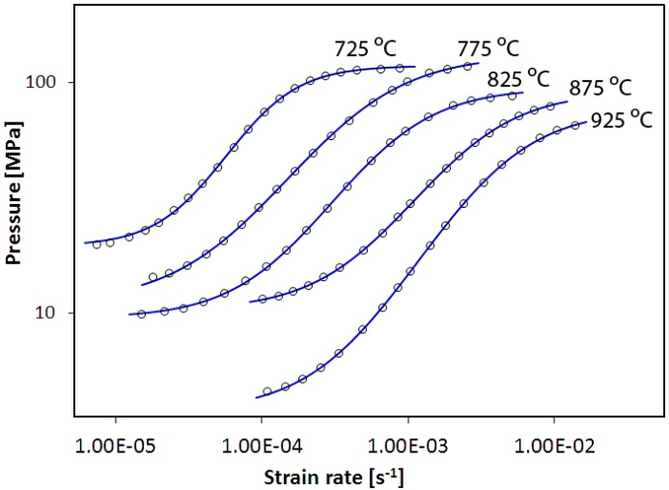
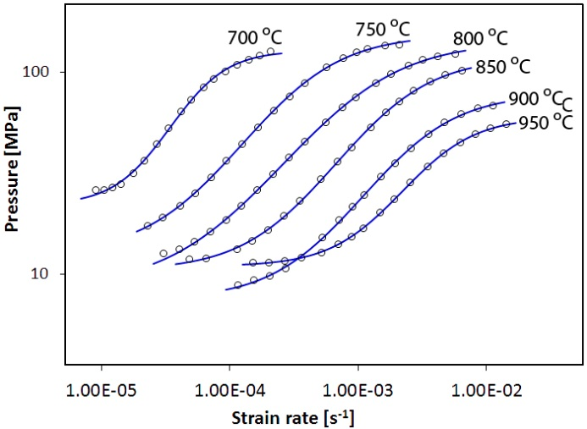
Stress-strain rate curves
The experimental (markers) and predicted (solid lines) stress-strain curves obtained by stepped tensile-tests

Slide 12
Stress-strain rate curves

Slide 13
Stress-strain rate curves

Slide 14
Stress-strain rate curves

Slide 15
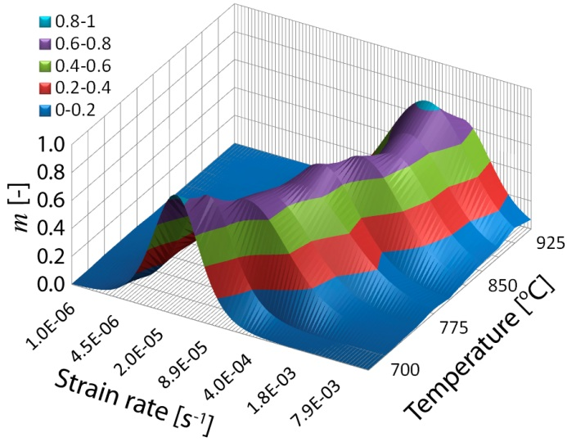
Strain rate sensitivity exponent

Slide 16
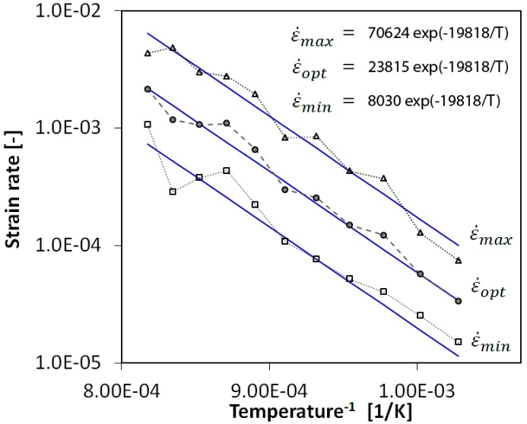
Optimum strain rate

Slide 17
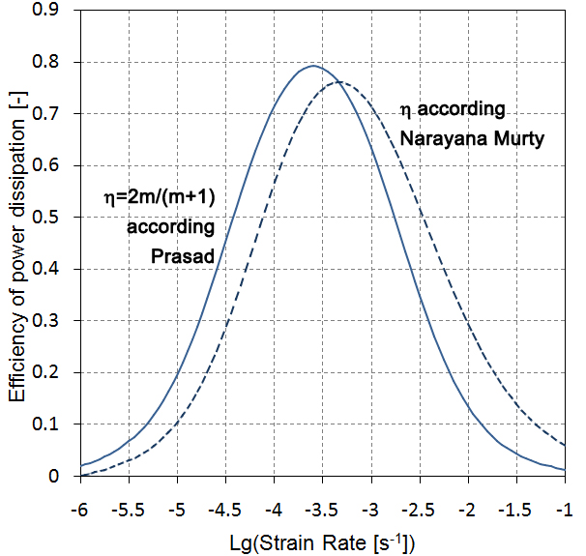
Efficiency of power dissipation

Slide 18
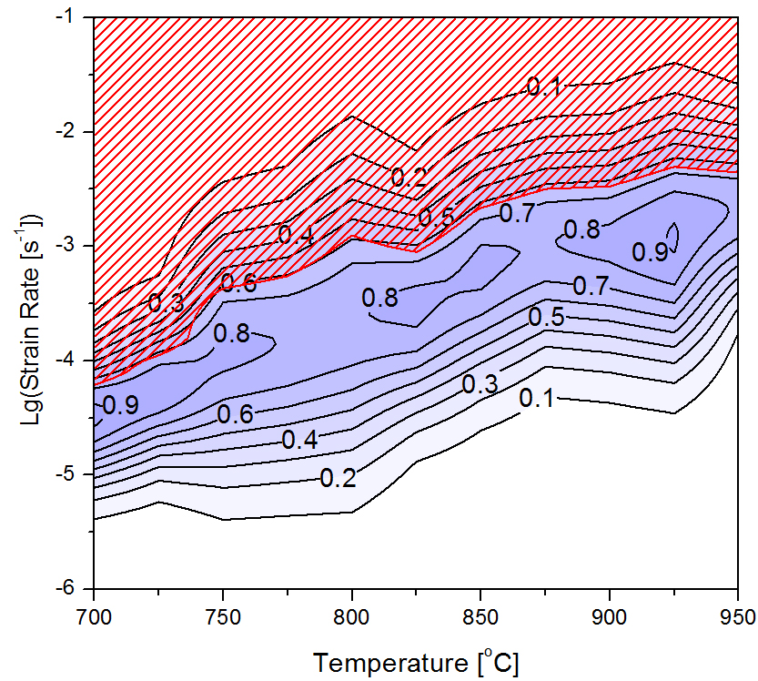
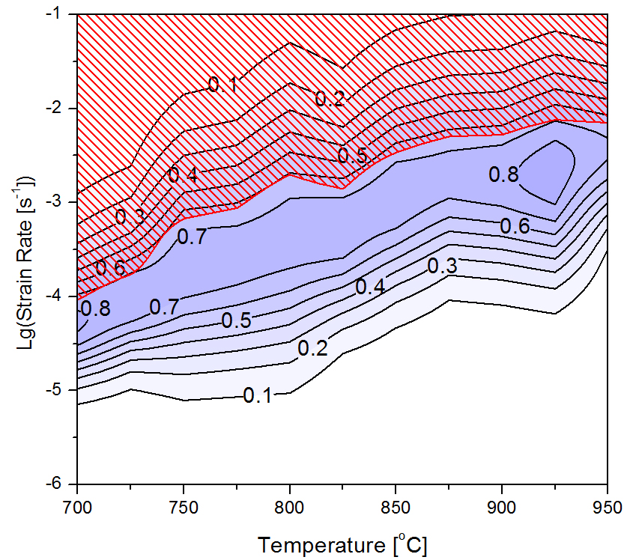
Processing maps
Prasad
Narayana Murty

Slide 19
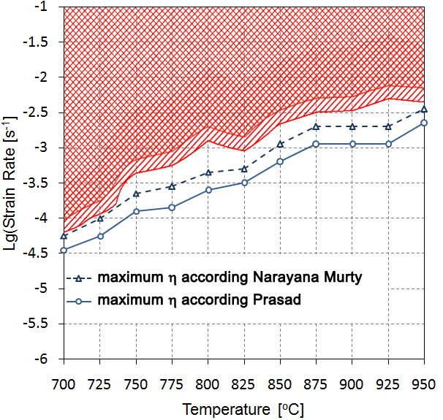

Maximum of $η$

Slide 20
Tension at 825 °C
Optimum = 3.8e-4

Slide 21
Tension at 875 °C
Optimum = 8.54e-4

Slide 22
Tension at 925 °C
Optimum = 1.4e-3

Slide 23
Stress-strain curves

Slide 24
Stress-strain rate curves

Slide 25
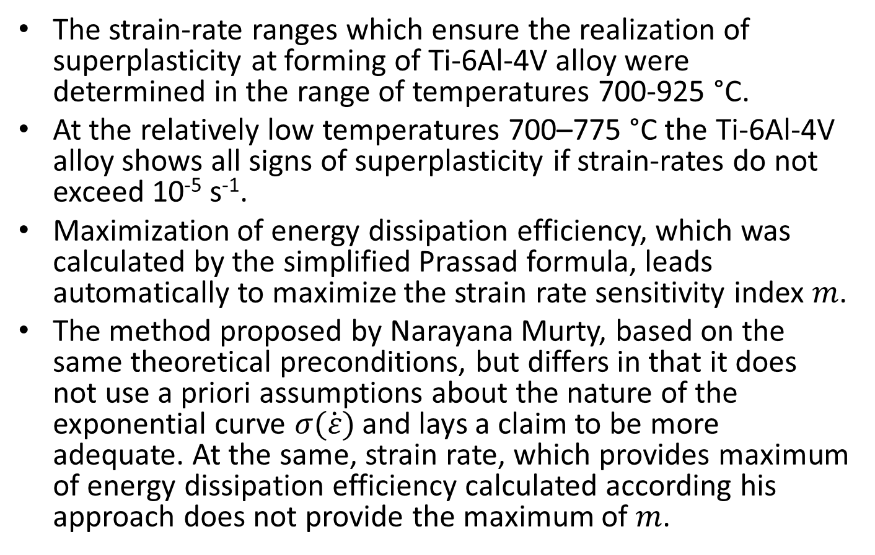
Summary
The strain-rate ranges which ensure the realization of superplasticity at forming of Ti-6Al-4V alloy were determined in the range of temperatures 700-925 °C.
At the relatively low temperatures 700–775 °C the Ti-6Al-4V alloy shows all signs of superplasticity if strain-rates do not exceed 10⁻⁵ s⁻¹.
Maximization of energy dissipation efficiency, which was calculated by the simplified Prassad formula, leads automatically to maximize the strain rate sensitivity index $m$.
The method proposed by Narayana Murty, based on the same theoretical preconditions, but differs in that it does not use a priori assumptions about the nature of the exponential curve $σ(\dot{ε})$ and lays a claim to be more adequate. At the same, strain rate, which provides maximum of energy dissipation efficiency calculated according his approach does not provide the maximum of $m$.

Slide 26
Thank you for your attention!

