Slide 1
3D anisotropic heat transfer simulations in outer layers of neutron stars
Moiseenko S.G., Kondratyev I.A.,
Bisnovatyi-Kogan G.S., Glushikhina M.V.
Space Research Institute RAS

Slide 2
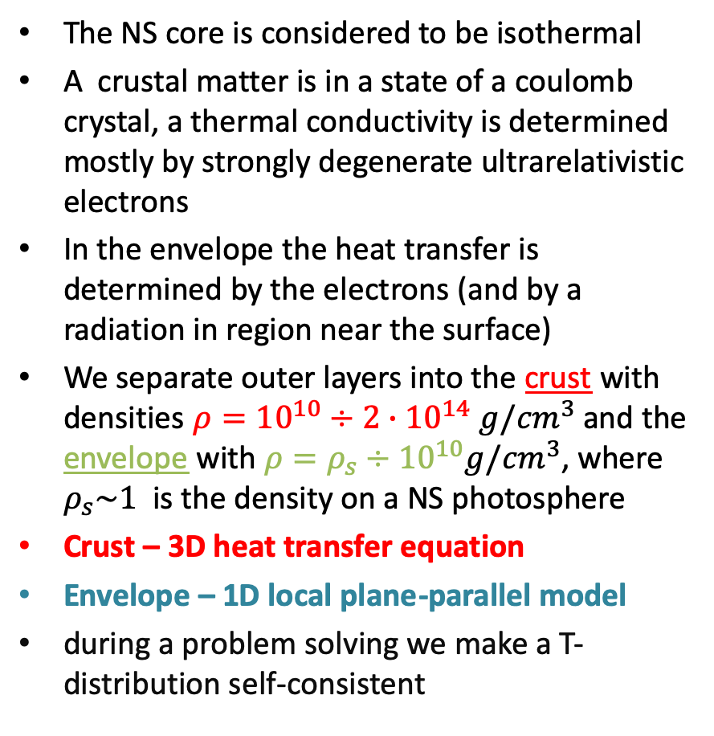
Heat transfer in NSs
The NS core is considered to be isothermal
A crustal matter is in a state of a coulomb crystal, a thermal conductivity is determined mostly by strongly degenerate ultrarelativistic electrons
In the envelope the heat transfer is determined by the electrons (and by a radiation in region near the surface)
We separate outer layers into the crust with densities $ρ={10}^{10}÷2∙{10}^{14}$ $g/{cm}^{3}$ and the envelope with $ρ={ρ_{s}÷10}^{10}g/{cm}^{3}$, where $ρ_{s}\sim 1$ is the density on a NS photosphere
Crust – 3D heat transfer equation
Envelope – 1D local plane-parallel model
during a problem solving we make a T-distribution self-consistent
Image: W.G. Newton,
Nature physics, 2013

Slide 3
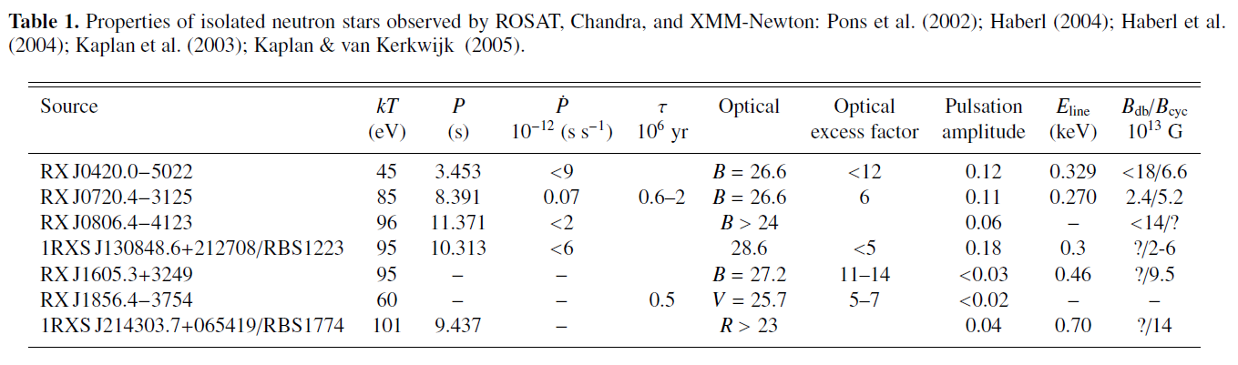
Observational data
Perez-Azorin, J. F., Miralles, J. A., & Pons, J. A. 2006, A&A, 451, 1009
Yakovlev, D. G. & Pethick, C. J. 2004, ARA&A, 42, 169
Periodic changes on thermal X-ray light curves of some single neutron stars (NSs) indicate its non-uniform surface temperature distribution
A possible cause of this phenomenon is a heat conductivity suppression across a magnetic field in outer layers of a magnetized NS
On the table – observational data from 7 thermally emitting NSs (“magnificent seven”)
MAGNIFICENT SEVEN --> MAGNIFICENT EIGHT!!! Due to discovery of a thermal component in PSR J0726-2612 (*)
(*) Rigoselli et al., 2019

Slide 4
Aim of this study
An aim of this work is to study 3D effects in the NS temperature, which may arise due to existence of non-axisymmetric magnetic field configurations (e.g. non-coaxial superposition of dipolar and quadrupolar fields)
For obtained T-distributions we have synthesized thermal light curves to look for some features on them, which may correspond to a presence of a quadrupolar component in a magnetic field

Slide 5

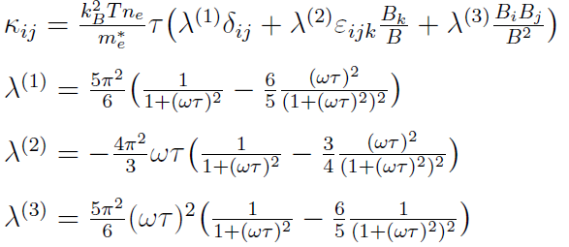
Anisotropic heat transfer in the NS crust
In the crust a temperature satisfies the heat transfer equation
With a thermal conductivity tensor (*)
Which was derived as a Boltzmann equation solution with a Chapman-Enskog method in a Lorentz approximation. This tensor has a much more complicated dependence on the magnetic field than in previous works, where the heat flux suppression is taken into account phenomenologically.
(*) G. S. Bisnovatyi-Kogan, M. V. Glushikhina Plasma Physics Reports, 2018, Vol. 44, No. 4, pp. 405-423

Slide 6

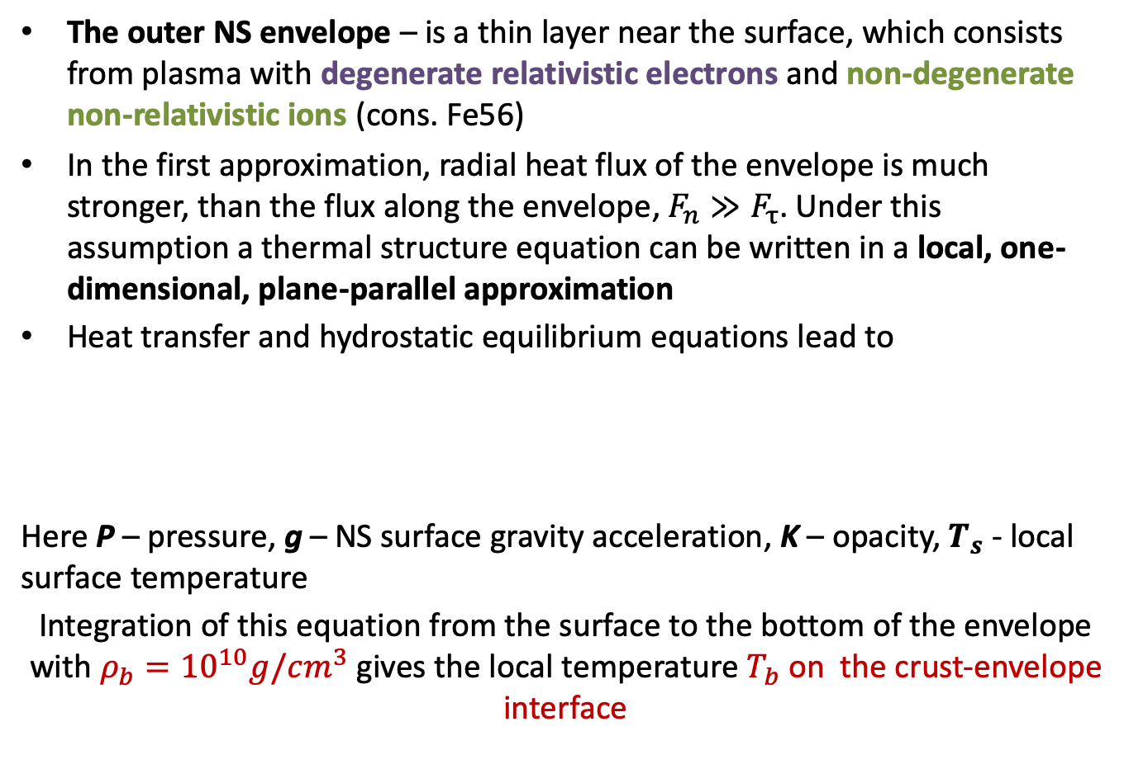
Thermal structure equation for the NS envelope
The outer NS envelope – is a thin layer near the surface, which consists from plasma with degenerate relativistic electrons and non-degenerate non-relativistic ions (cons. Fe56)
In the first approximation, radial heat flux of the envelope is much stronger, than the flux along the envelope, $F_{n}≫F_{τ}$. Under this assumption a thermal structure equation can be written in a local, one-dimensional, plane-parallel approximation
Heat transfer and hydrostatic equilibrium equations lead to
Here P – pressure, g – NS surface gravity acceleration, K – opacity, $T_{s}$ - local surface temperature
Integration of this equation from the surface to the bottom of the envelope with $ρ_{b}={10}^{10}g/{cm}^{3}$ gives the local temperature $T_{b}$ on the crust-envelope interface

Slide 7

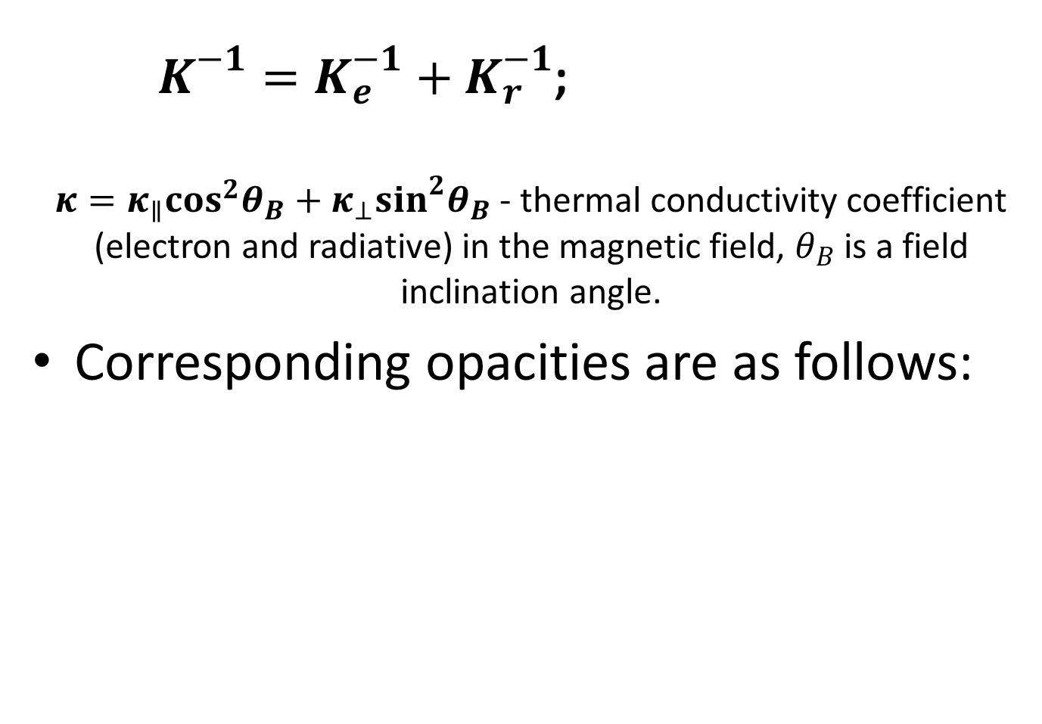
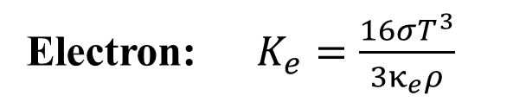
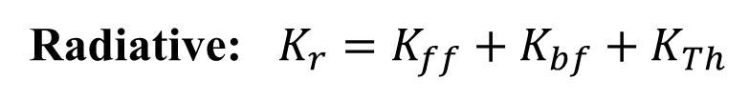
Effective opacity
$K^{−1}=K_{e}^{−1}+K_{r}^{−1}$;
$κ=κ_{∥}\cos^{2}θ_{B}+κ_{⊥}\sin^{2}θ_{B}$ - thermal conductivity coefficient (electron and radiative) in the magnetic field, $θ_{B}$ is a field inclination angle.
Corresponding opacities are as follows:
$$κ=κ_{e}+κ_{r}$$
Electron: $K_{e}=\frac{16σT^{3}}{3κ_{e}ρ}$
Radiative: $K_{r}=K_{ff}+K_{bf}+K_{Th}$

Slide 8
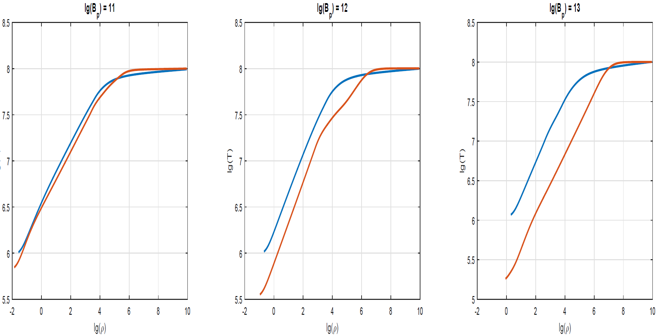
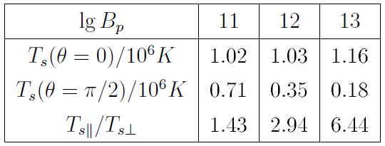





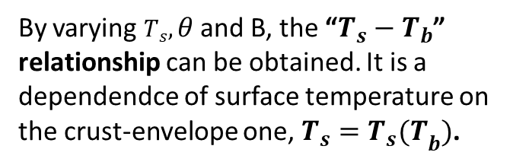
Thermal structure of the magnetized envelope
$$B_{p}={10}^{11}G$$
$$B_{p}={10}^{12}G$$
$$B_{p}={10}^{13}G$$
Lg(T)
pole
pole
pole
equator
equator
equator
Lg($ρ$)
$$T_{b}={10}^{8}K$$
By varying $T_{s},θ$ and B, the “$T_{s}−T_{b}$” relationship can be obtained. It is a dependendce of surface temperature on the crust-envelope one, $T_{s}={T_{s}(T}_{b})$.

Slide 9

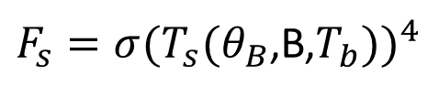
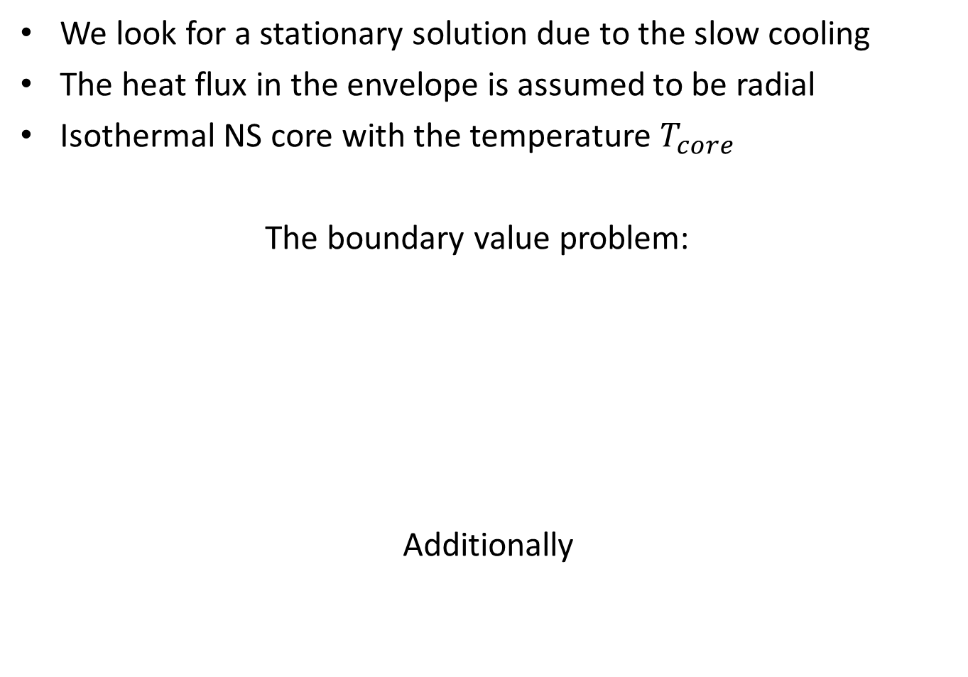
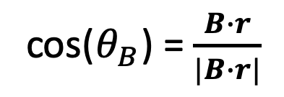
A boundary-value problem for the heat transfer equation in the NS crust
We look for a stationary solution due to the slow cooling
The heat flux in the envelope is assumed to be radial
Isothermal NS core with the temperature $T_{core}$
The boundary value problem:
Additionally
cos($θ_{B}$) = $\frac{B∙r}{|B∙r|}$
$F_{s}=σ(T_{s}(θ_{B}$,B,$T_{b}))^{4}$

Slide 10
Numerical technique
(Basic operators method)
Difference analogues of differential operators satisfy the same identities as the continuous ones
Completely conservative finite-difference schemes
Unstructured meshes (no allocated directions)
Mesh refinement can be included
Approximation of order O(h), h – characteristic cell size

Slide 11
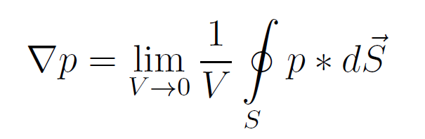
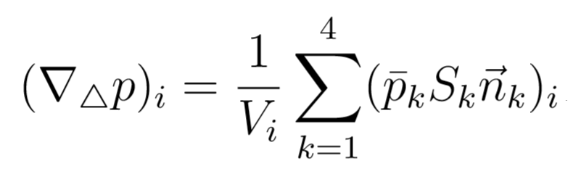
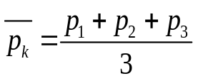
Difference GRAD operator (nodes → cells)
Invariant definition of a GRAD operator:
Integration of a node function over the boundary of the cell with a mean theorem
- average value of the function in the k-th face of the tetrahedron
It also can be obtained with the linear interpolation of the node function and L-coordinates
4
3
1
2
Kondratyev I.A., Moiseenko S.G. 2019,JPhCS,1163 012069

Slide 12
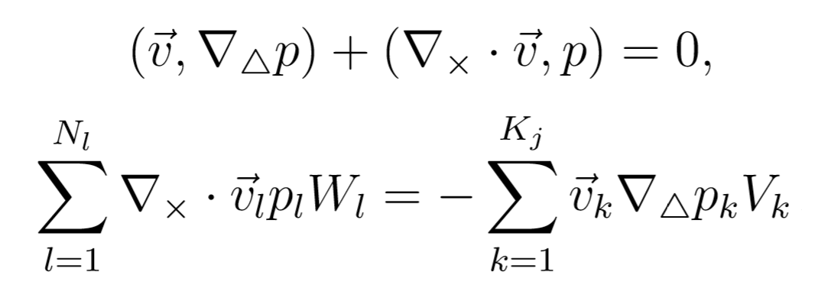


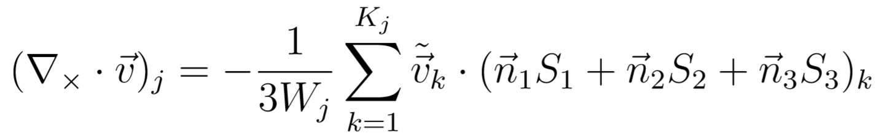
Difference DIV operator (cells → interior nodes)
The Green formula in the infinite space and its grid analogue
By writing down the in the grid analogue, the following DIV approximation may be derived
Indexes 1, 2 and 3 correspond only to faces which are adjoin to the sought for j-th node
            - “Node volume”

Slide 13
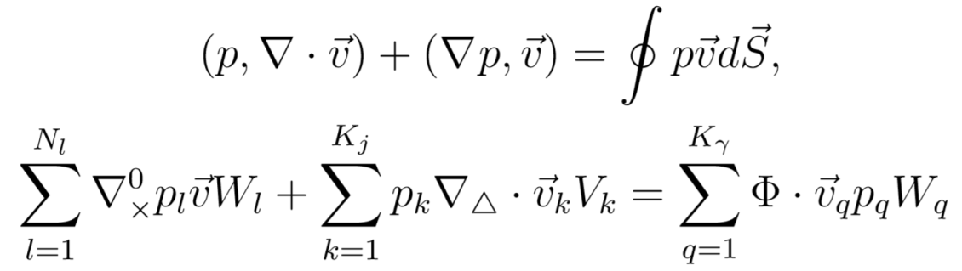
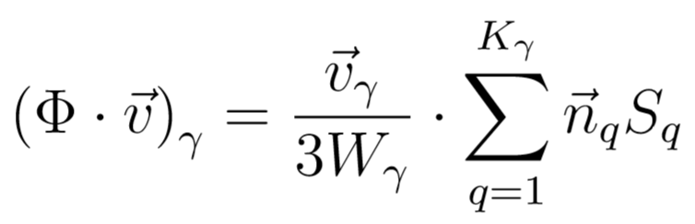
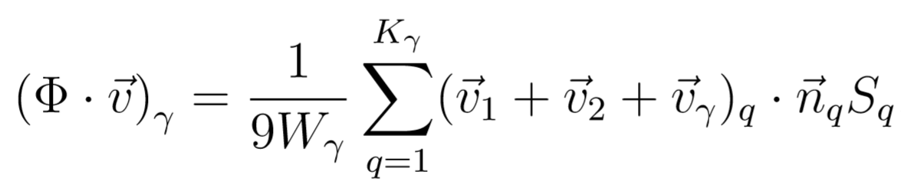

Boundary operator
$$Φ$$
Derivative in boundary nodes
Allows to take boundary conditions of 2nd and 3rd type into account
Satisfies to the Green formula in the region with bound
Numerical integration gives

Slide 14
Application of the Basic operator method to the solving problem
We solve the only operator-difference equation, which takes into account both boundary conditions and the heat transfer equation itself:
Non-linear problem is solved with a Newton method for a system of non-linear equations
We solve the problem iteratively, until inequality |T_s^(n-1)-T_s^(n)|/T_s^(n) < eps is not satisfied (in some sense it is treated as a “time”-dependent heat transfer equation)

Slide 15
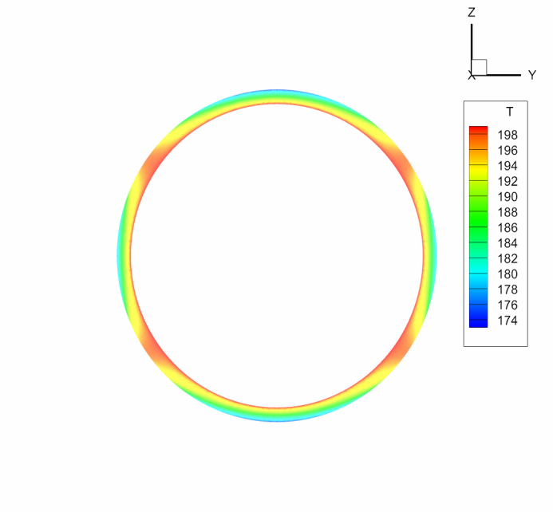
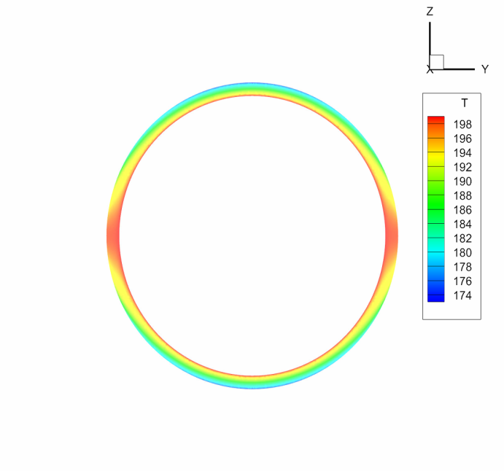
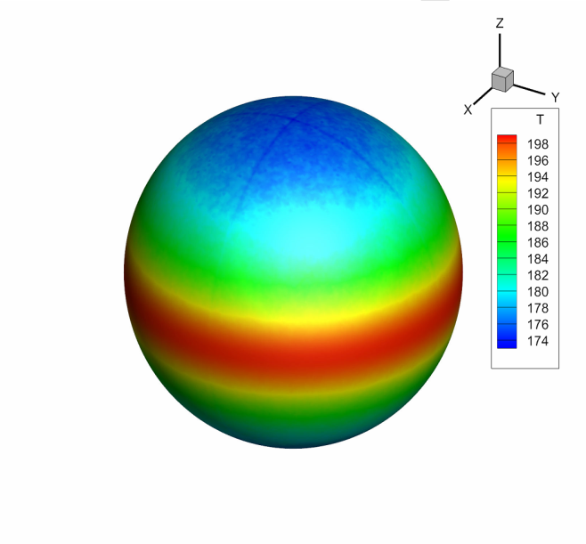
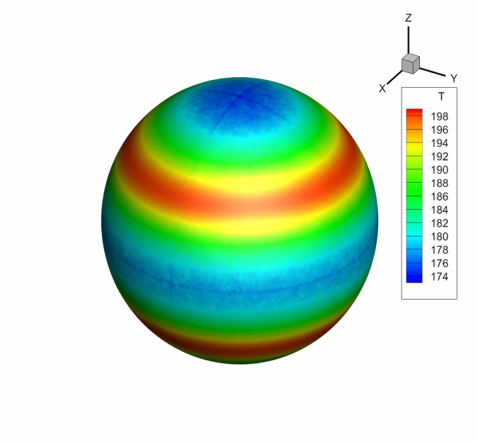
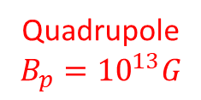
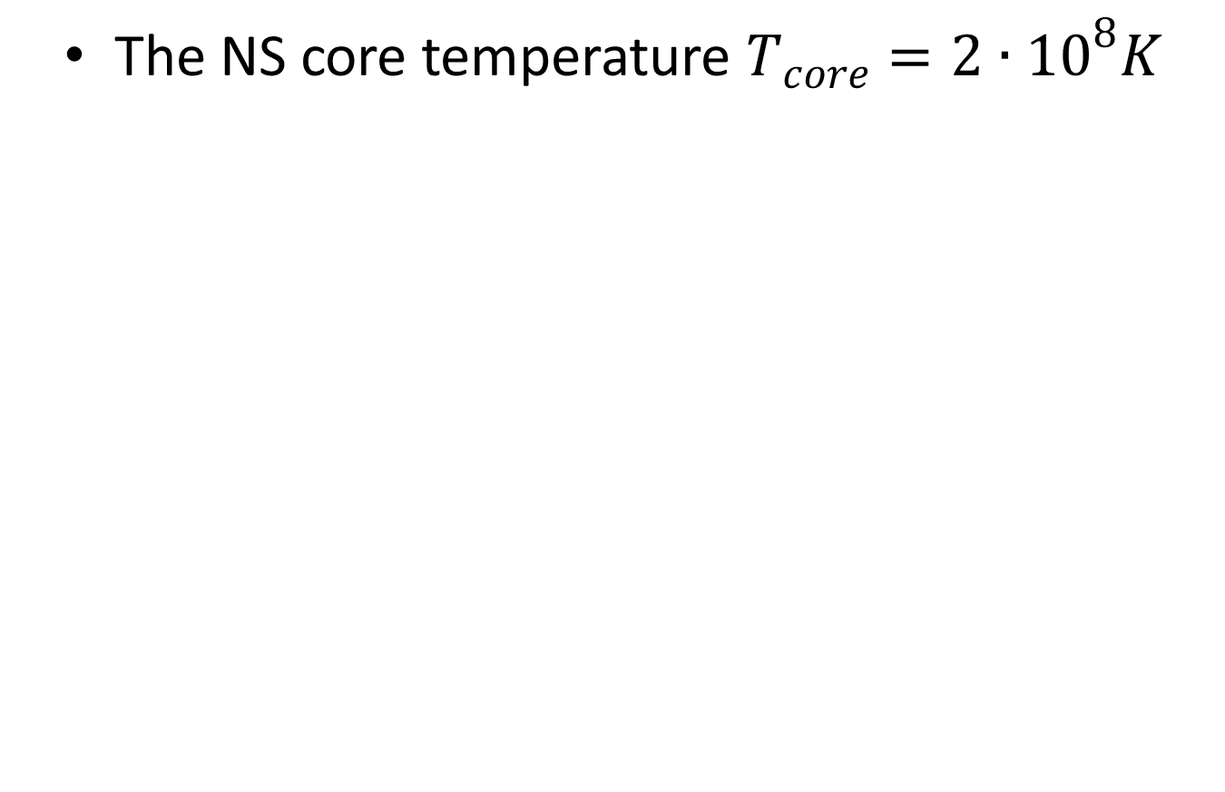
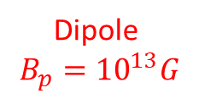
Computation results (crust)
The NS core temperature $T_{core}={2∙10}^{8}K$
Dipole
$$B_{p}={10}^{13}G$$
Quadrupole
$$B_{p}={10}^{13}G$$

Slide 16
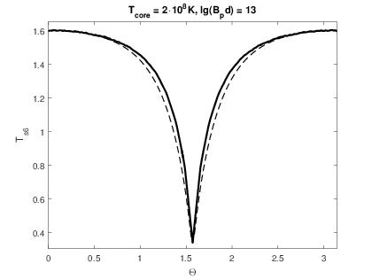
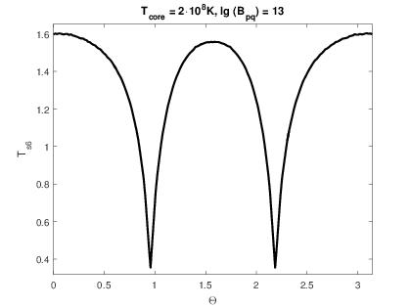
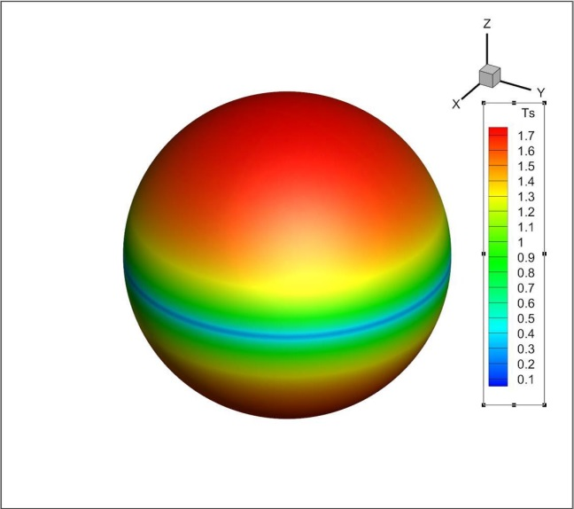
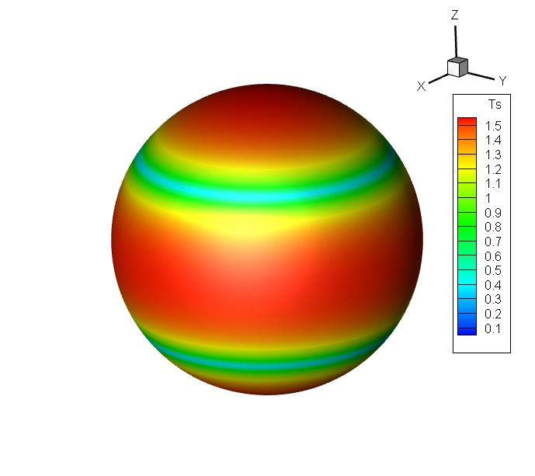

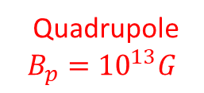

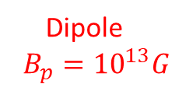
Computation results (surface)
Surface temperature distribution
T-distribution =
Hot polar caps + cold belt(s)
$$T_{s(max)}≈{1.6∙10}^{6}K$$
$$T_{s(min)}≈{0.3∙10}^{6}K$$
Dipole
$$B_{p}={10}^{13}G$$
Quadrupole
$$B_{p}={10}^{13}G$$

Slide 17
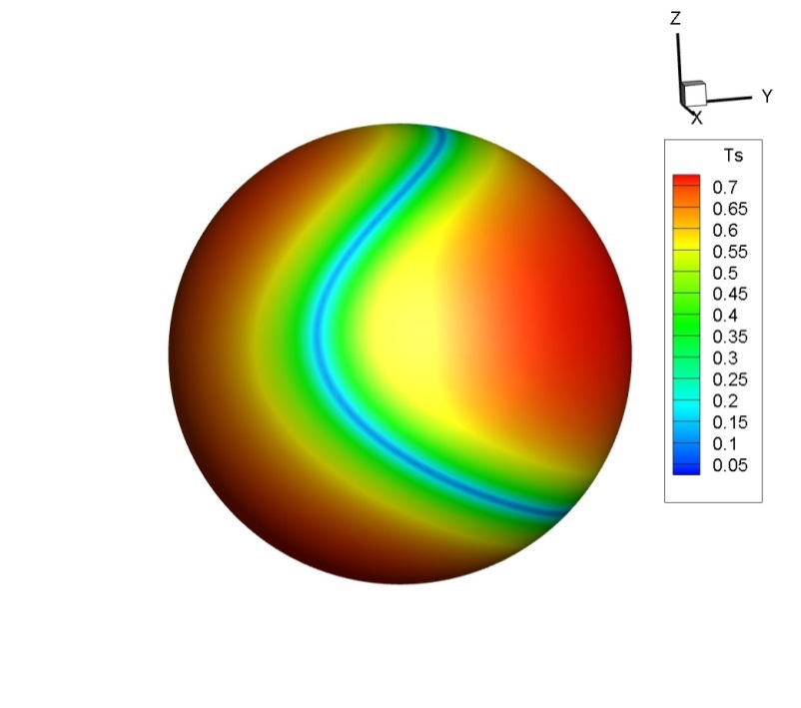
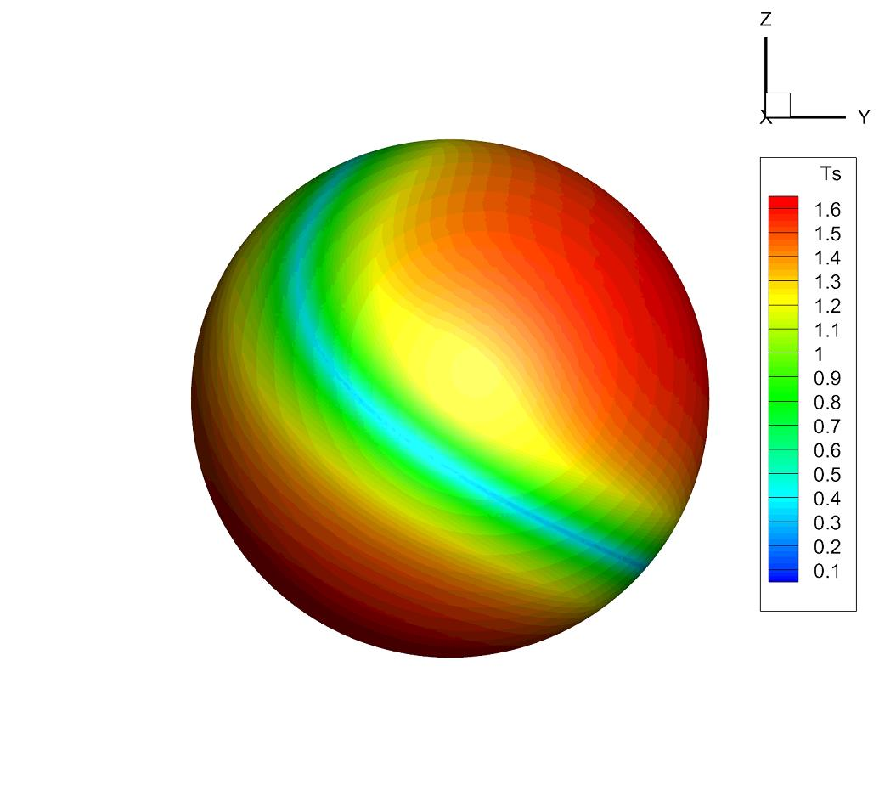
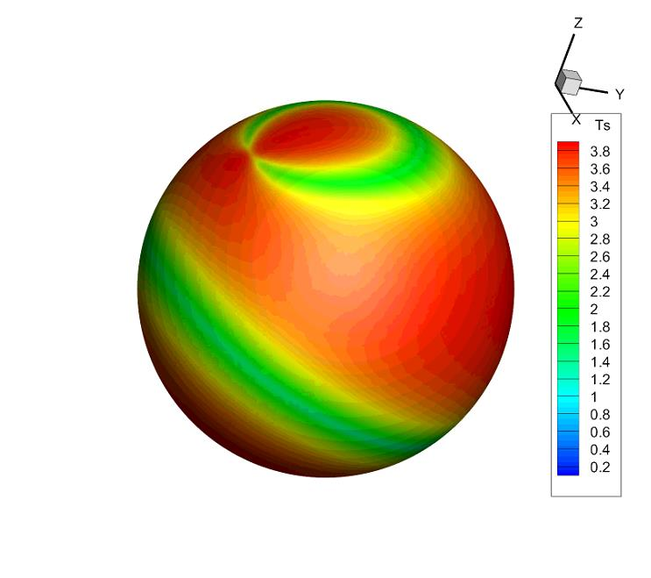
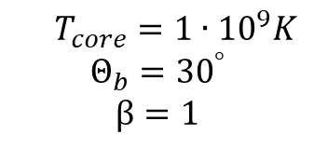
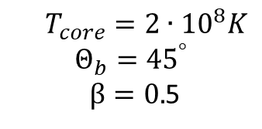
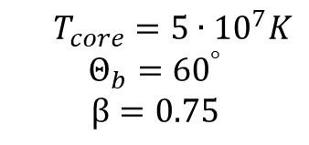

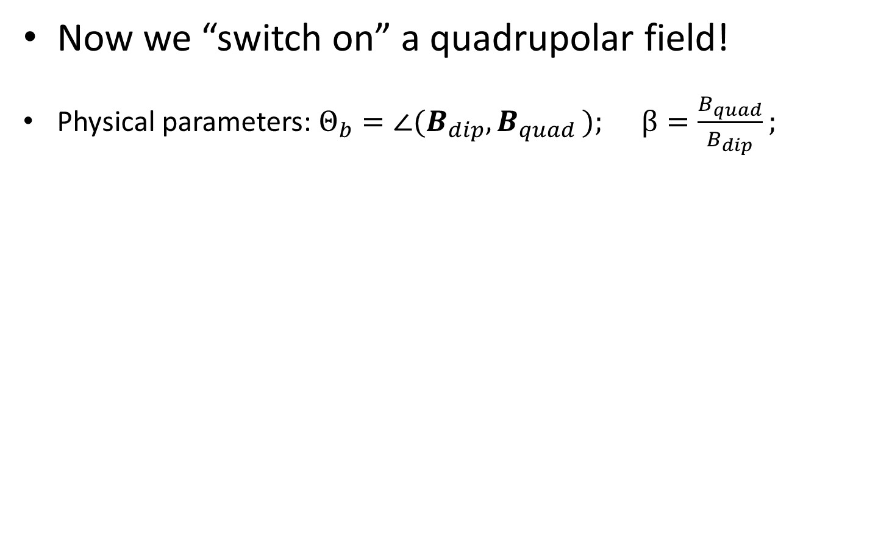


Computation results (+quadrupole)
Now we “switch on” a quadrupolar field!
Physical parameters: $Θ_{b}={∠(B}_{dip}{,B}_{quad}); β=\frac{B_{quad}}{B_{dip}};$
$$T_{s(max)}/T_{s(min)}≈7$$
$$T_{s(max)}/T_{s(min)}≈5$$
$$T_{s(max)}/T_{s(min)}≈2.5$$
$T_{core}={5∙10}^{7}K$
$$Θ_{b}={60}^{°}$$
$$β=0.75$$
$T_{core}={2∙10}^{8}K$
$$Θ_{b}={45}^{°}$$
$β=0.$5
$T_{core}={1∙10}^{9}K$
$$Θ_{b}={30}^{°}$$
$$β=1$$

Slide 18
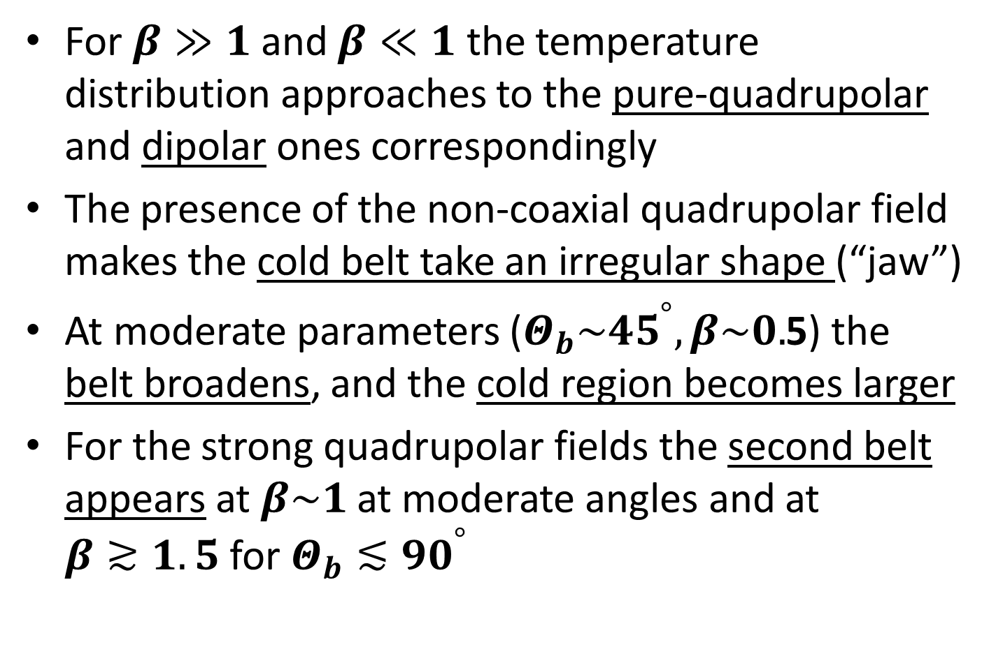
Main results for the NS surface temperature
For $β≫1$ and $β≪1$ the temperature distribution approaches to the pure-quadrupolar and dipolar ones correspondingly
The presence of the non-coaxial quadrupolar field makes the cold belt take an irregular shape (“jaw”)
At moderate parameters ($Θ_{b}\sim {45}^{°},β\sim 0.$5) the belt broadens, and the cold region becomes larger
For the strong quadrupolar fields the second belt appears at $β\sim 1$ at moderate angles and at $β≳1.5$ for $Θ_{b}≲{90}^{°}$

Slide 19
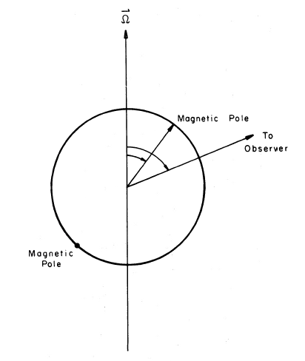
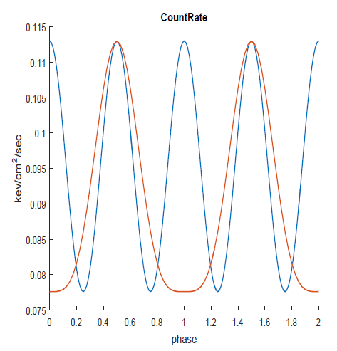
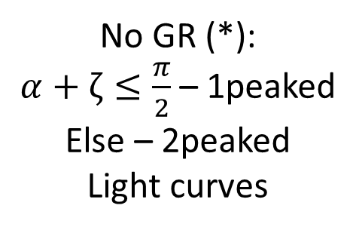


Synthetic light curves
Composite black-body model (locally equilibrium)
General relativity effects, taken into account:
1. Gravitational redshift
2. Light bending =>
an effective NS radius and a body angle increase for
an observer at the infinite distance
α
ζ
D.Page 1995,
ApJ, 442, 273
Light curve (dipolar)
$$α=ζ=\frac{π}{2}$$
(*) Greenstein G., Hartke G.J.
1983, ApJ, 271, 283
No GR (*):
$α+ζ≤\frac{π}{2}$ – 1peaked
Else – 2peaked
Light curves
$$α=ζ=\frac{π}{4}$$

Slide 20
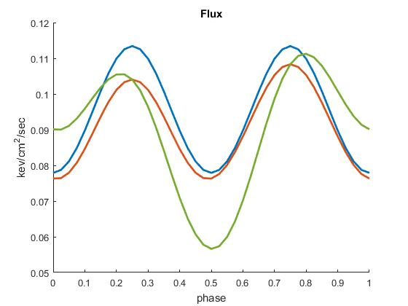
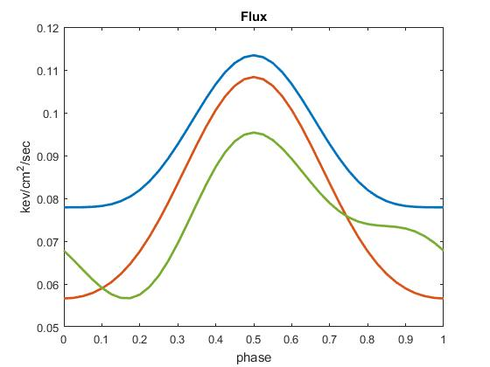
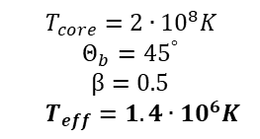


Observational manifestations (preliminary)
Two limits for positions of rotational, quadrupolar and dipolar axes
Pulsations can be increased sufficiently!
Peak symmetry is broken, if all three axes are not in the same plane
Pulse shape may change due to GR effects (2p->1p)
$$α=ζ=\frac{π}{2}$$
$T_{core}={2∙10}^{8}K$
$$Θ_{b}={45}^{°}$$
$$β=0.5$$
$T_{eff}={1.4∙10}^{6}K$
$$α=ζ=\frac{π}{4}$$

Slide 21
Summary
We have studied 3D effects in the heat transfer in the magnetized neutron stars using the Basic operators numerical method
Surface temperature distributions with inclusion of a quadrupolar field change sufficiently from the pure-dipolar ones
A presence of the magnetic fields with no axial symmetry, in principle, can be detectable due to special features on the thermal light curves

